Slide 1


Interferometric transmission probing with coded mutual intensity
Alankar Kotwal, Anat Levin, and Ioannis Gkioulekas
Notes:
Hello everyone, I’m Alankar and I’ll be talking about probing light transport using interferometry.

Slide 2
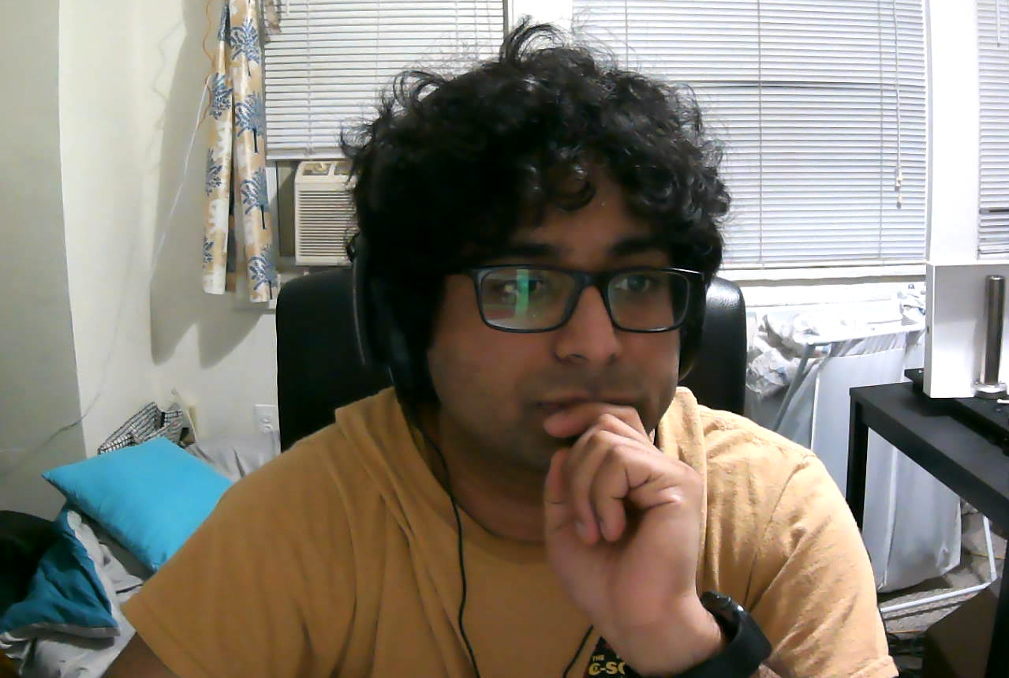

Interferometric transmission probing with coded mutual intensity
Alankar Kotwal ¹
Anat Levin ²
Ioannis Gkioulekas ¹
¹ Carnegie Mellon University
² Technion

Slide 3
Image formation
camera
light
5 mm
hidden pattern
pattern plane, side view
Notes:
I’ll start with a quick first example of what I mean by probing and what it can be useful for.
Consider a scene where we have a simple two-stripe pattern,
[C] printed on a plane.
[C] We use a light to illuminate the pattern, and a camera focused on the plane to image it.

Slide 4
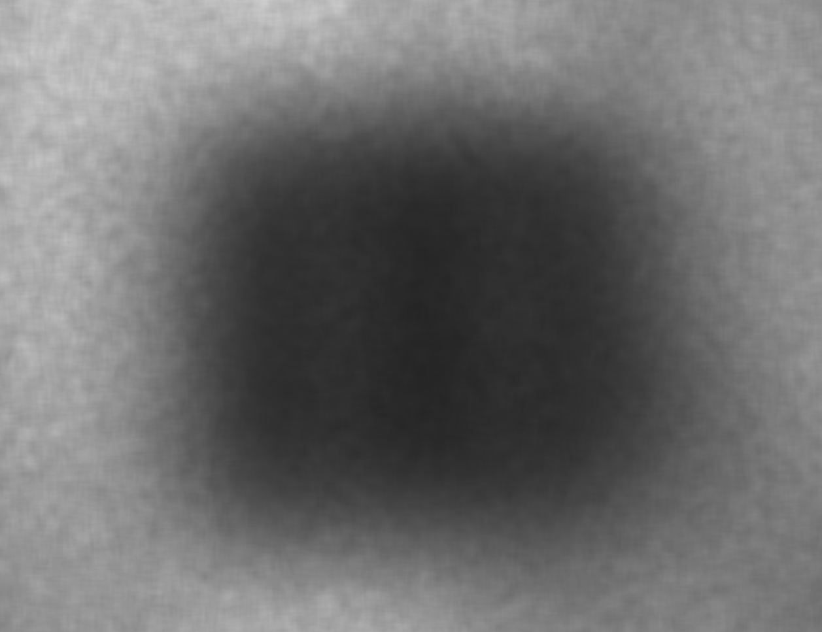
Image formation through scattering
camera
scattering
medium
light
image from a regular camera
scattering
medium
1 cm
blurred pattern
pattern plane, side view
Notes:
Let’s now place a scattering slab, such as a tissue phantom, on top of the pattern.
This slab scatters light, and as a result
[C] the camera will now measure light that scatters multiple times,
[C] or backscatters without ever reaching the pattern.
[C] As a result, the camera captures an image that is blurred, to the extent that we can no longer make out the spatial pattern.

Slide 5
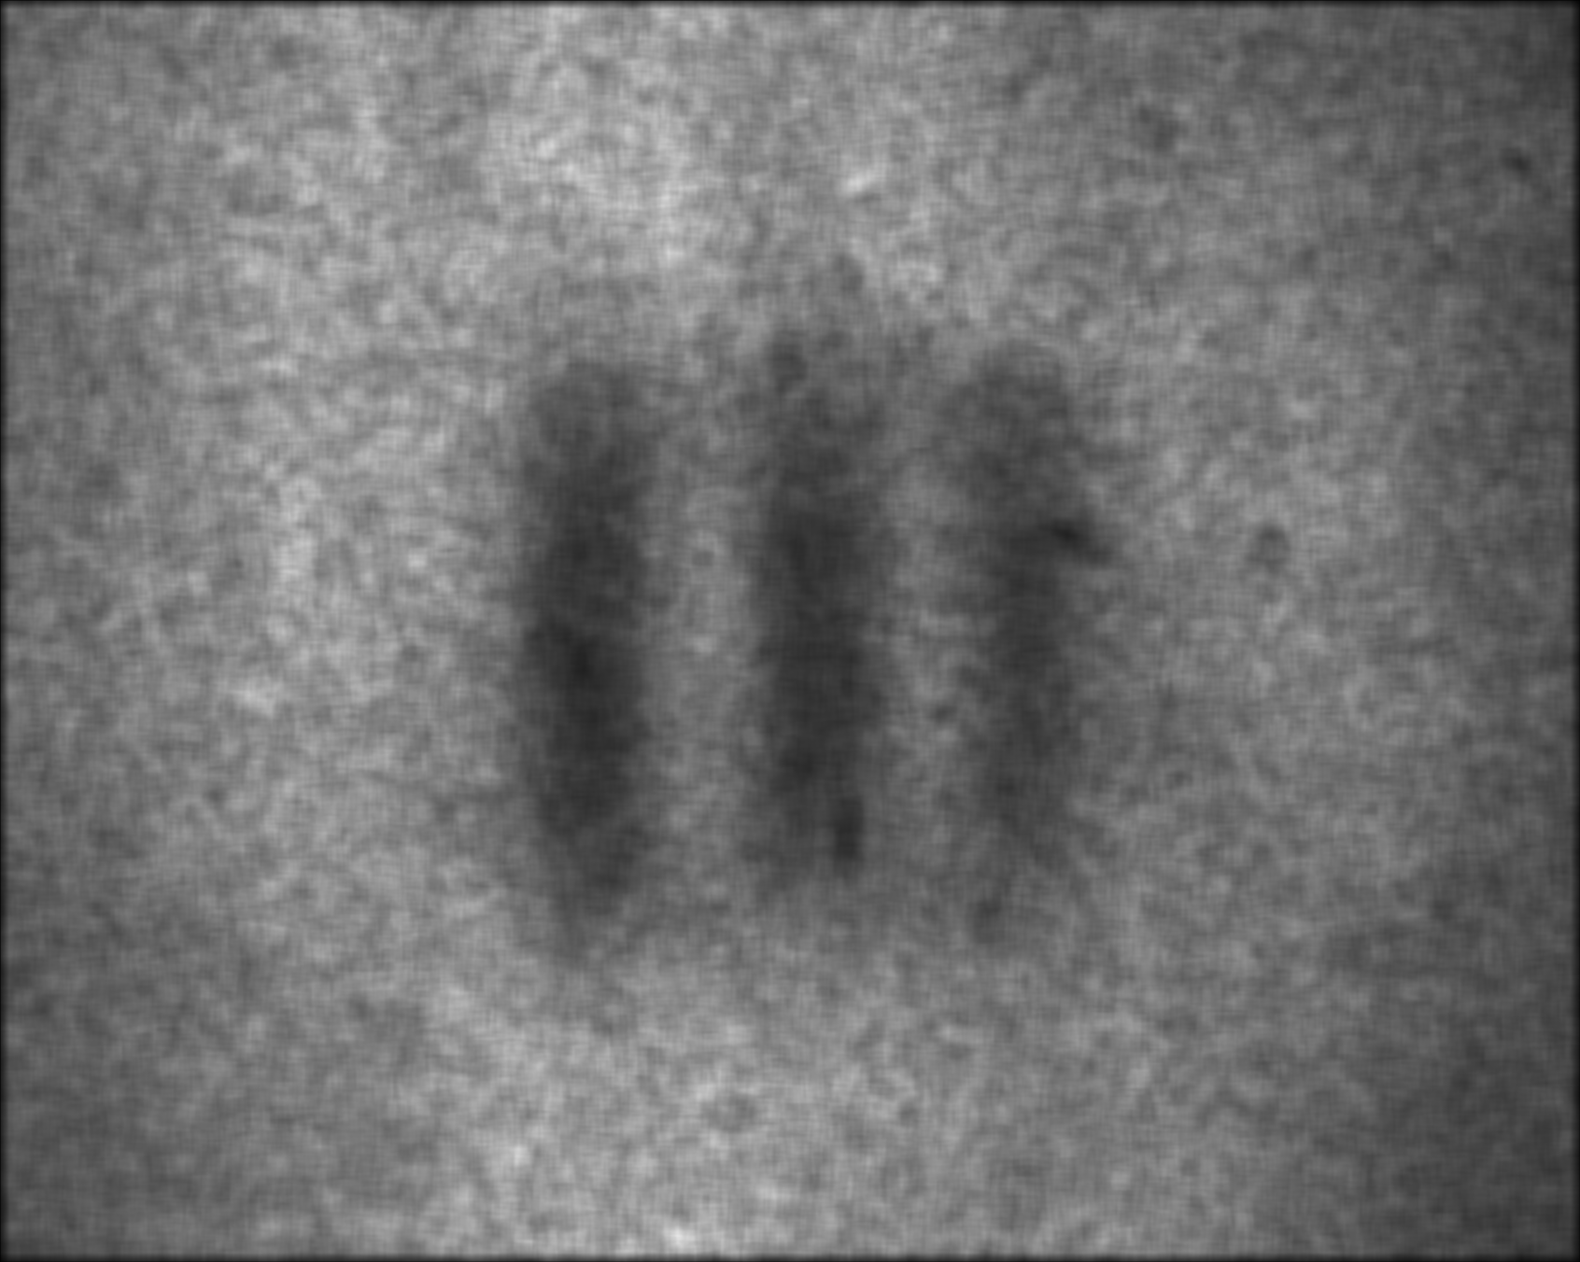
Probing light paths
camera
light
image from a regular camera
scattering
medium
image from our camera
pattern plane, side view
Notes:
What our camera allows us to do is optically remove contributions from the multiply-scattered and backscattered paths, and sense only the red ones, as if the slab were not there.
This allows us to capture an image where the pattern is visible again, without the need for any computational post-processing.
We call this selective sensing of specific light paths probing.

Slide 6
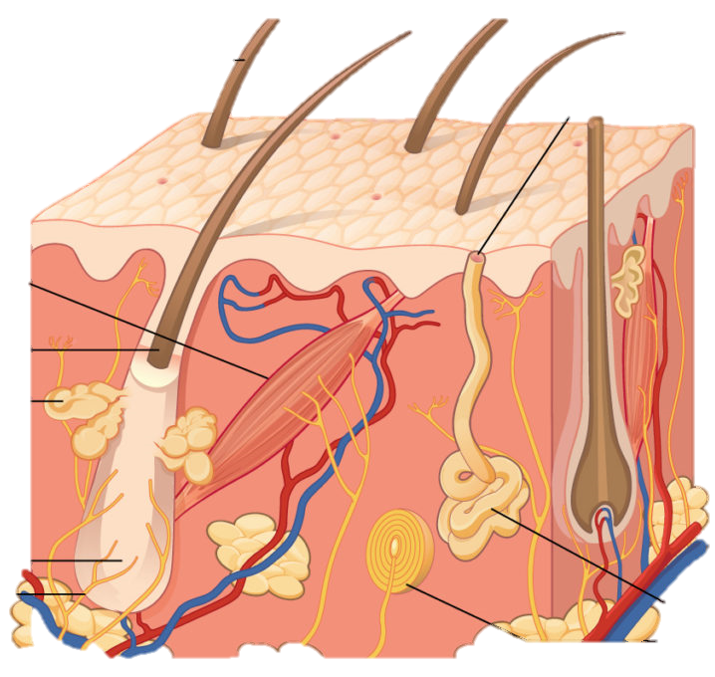
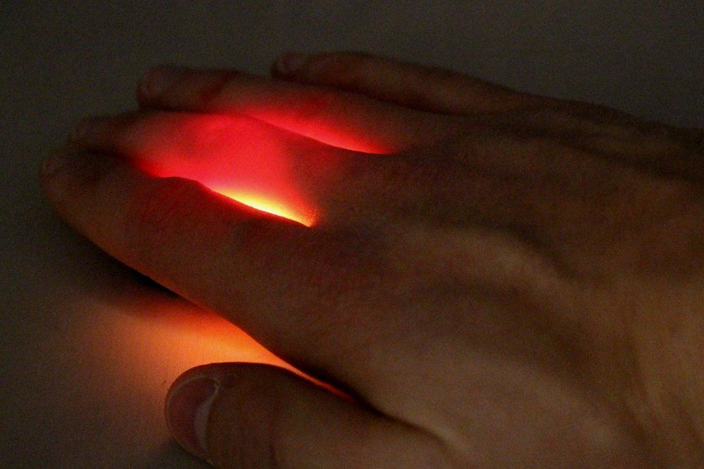
Seeing below the skin
what we want to see
what we actually see
https://www.seebelowtheskin.org/
Notes:
This type of probing is relevant for tissue imaging applications using visible light, which scatters strongly in tissue. By appropriately probing the light emerging from the skin, as in the previous example, we can hope to discern small tissue features below the skin.
In fact, this work is part of a 10-million-dollar project that aims to make seeing under the skin possible.

Slide 7
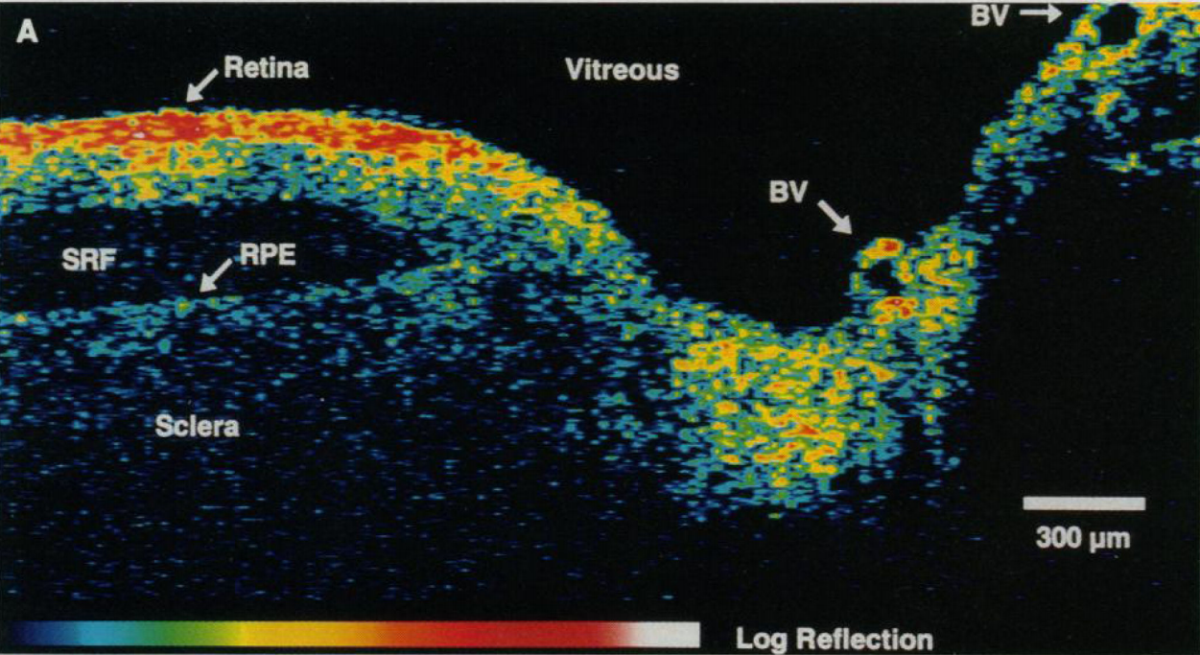
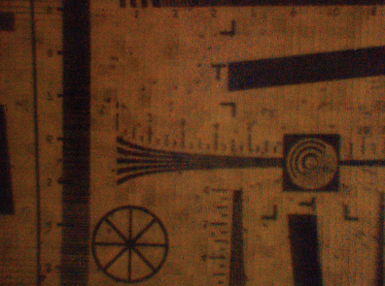
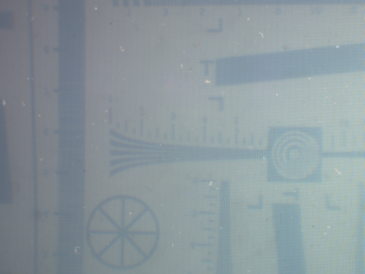
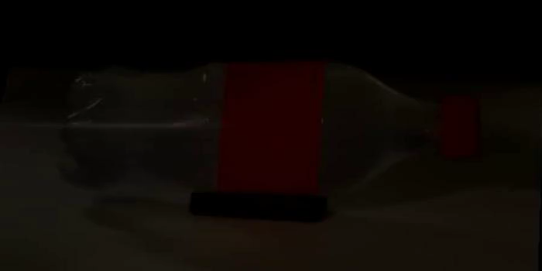
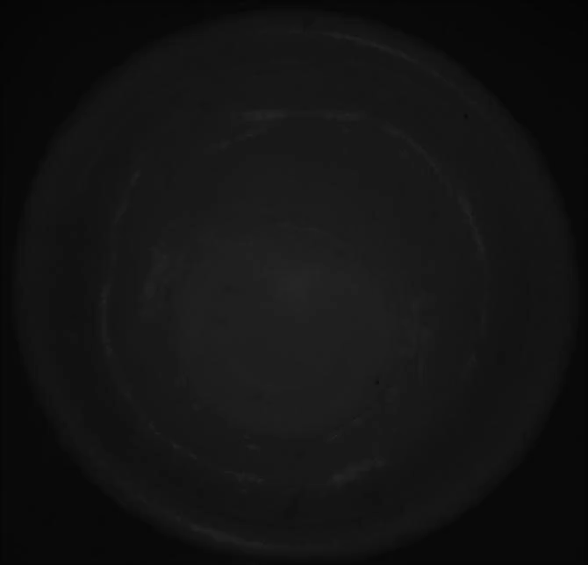
Previous work
transient imaging
spatial probing
probing by time-of-flight
microscopic resolution
spatial probing
programmable spatial probing
probing by time-of-flight
macroscopic
resolution
[Huang et al. 1991]
[O’Toole et al. 2012, 2014,
Achar et al. 2017]
probing by time-of-flight
spatial probing
macroscopic
resolution
probing by
time-of-flight
spatial probing
microscopic resolution
no programmability
very few probing types possible
[Velten et al. 2013, Heide et al. 2013,
Kadambi et al. 2013, Gariepy et al. 2015]
[Gkioulekas et al. 2015]
Notes:
There is a long history of imaging techniques that probe light paths in different ways.
[C] Transient imaging techniques filter paths based on time-of-flight. For example, Huang et al. introduced optical coherence tomography, a technique with micron-scale resolution commonly used for tissue imaging.
[C] There are also techniques for macroscopic transient imaging, using sensors such as streak cameras, SPADs, and continuous-wave time of flight.
[C] Closer to my earlier example are spatial probing techniques that filter paths based on their endpoints. O’Toole et al. first demonstrated this for macroscopic scenes using projector-camera systems, and later combined spatial probing and transient imaging using time-of-flight sensors.
[C] Gkioulekas et al achieved the same at micron-scale resolutions, using interferometry. This method, however, was severely restricted in terms of the types of spatial probing it could implement and changing probing patterns required changing the hardware setup.
[C] We introduce a new interferometric technique that combines the flexibility and programmability of previous spatial probing techniques, with the micron-scale resolution of optical coherence tomography, making it well-suited for tissue imaging applications.

Slide 8
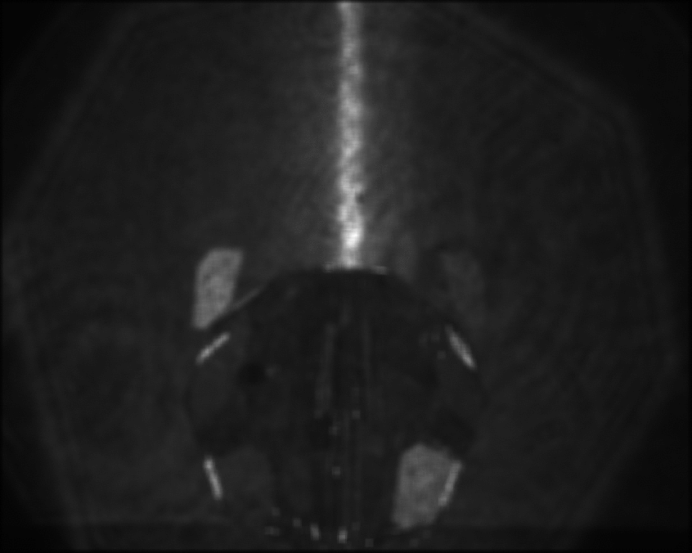

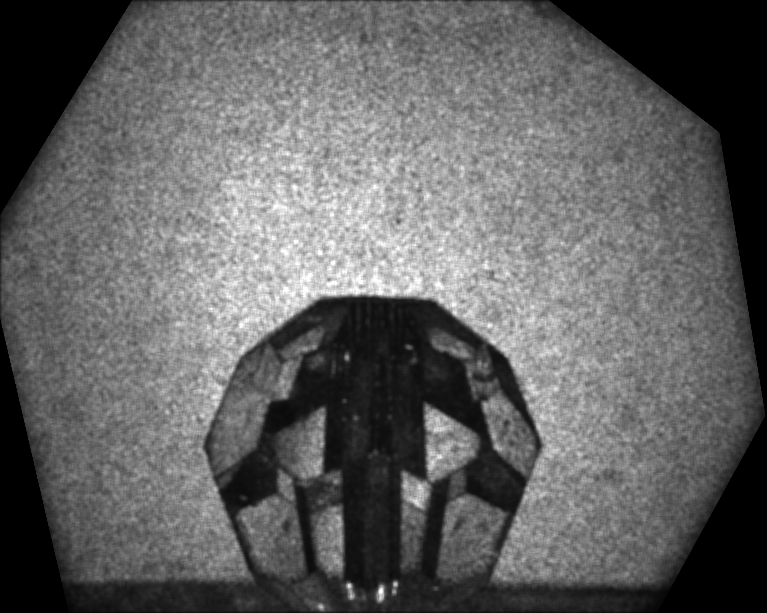
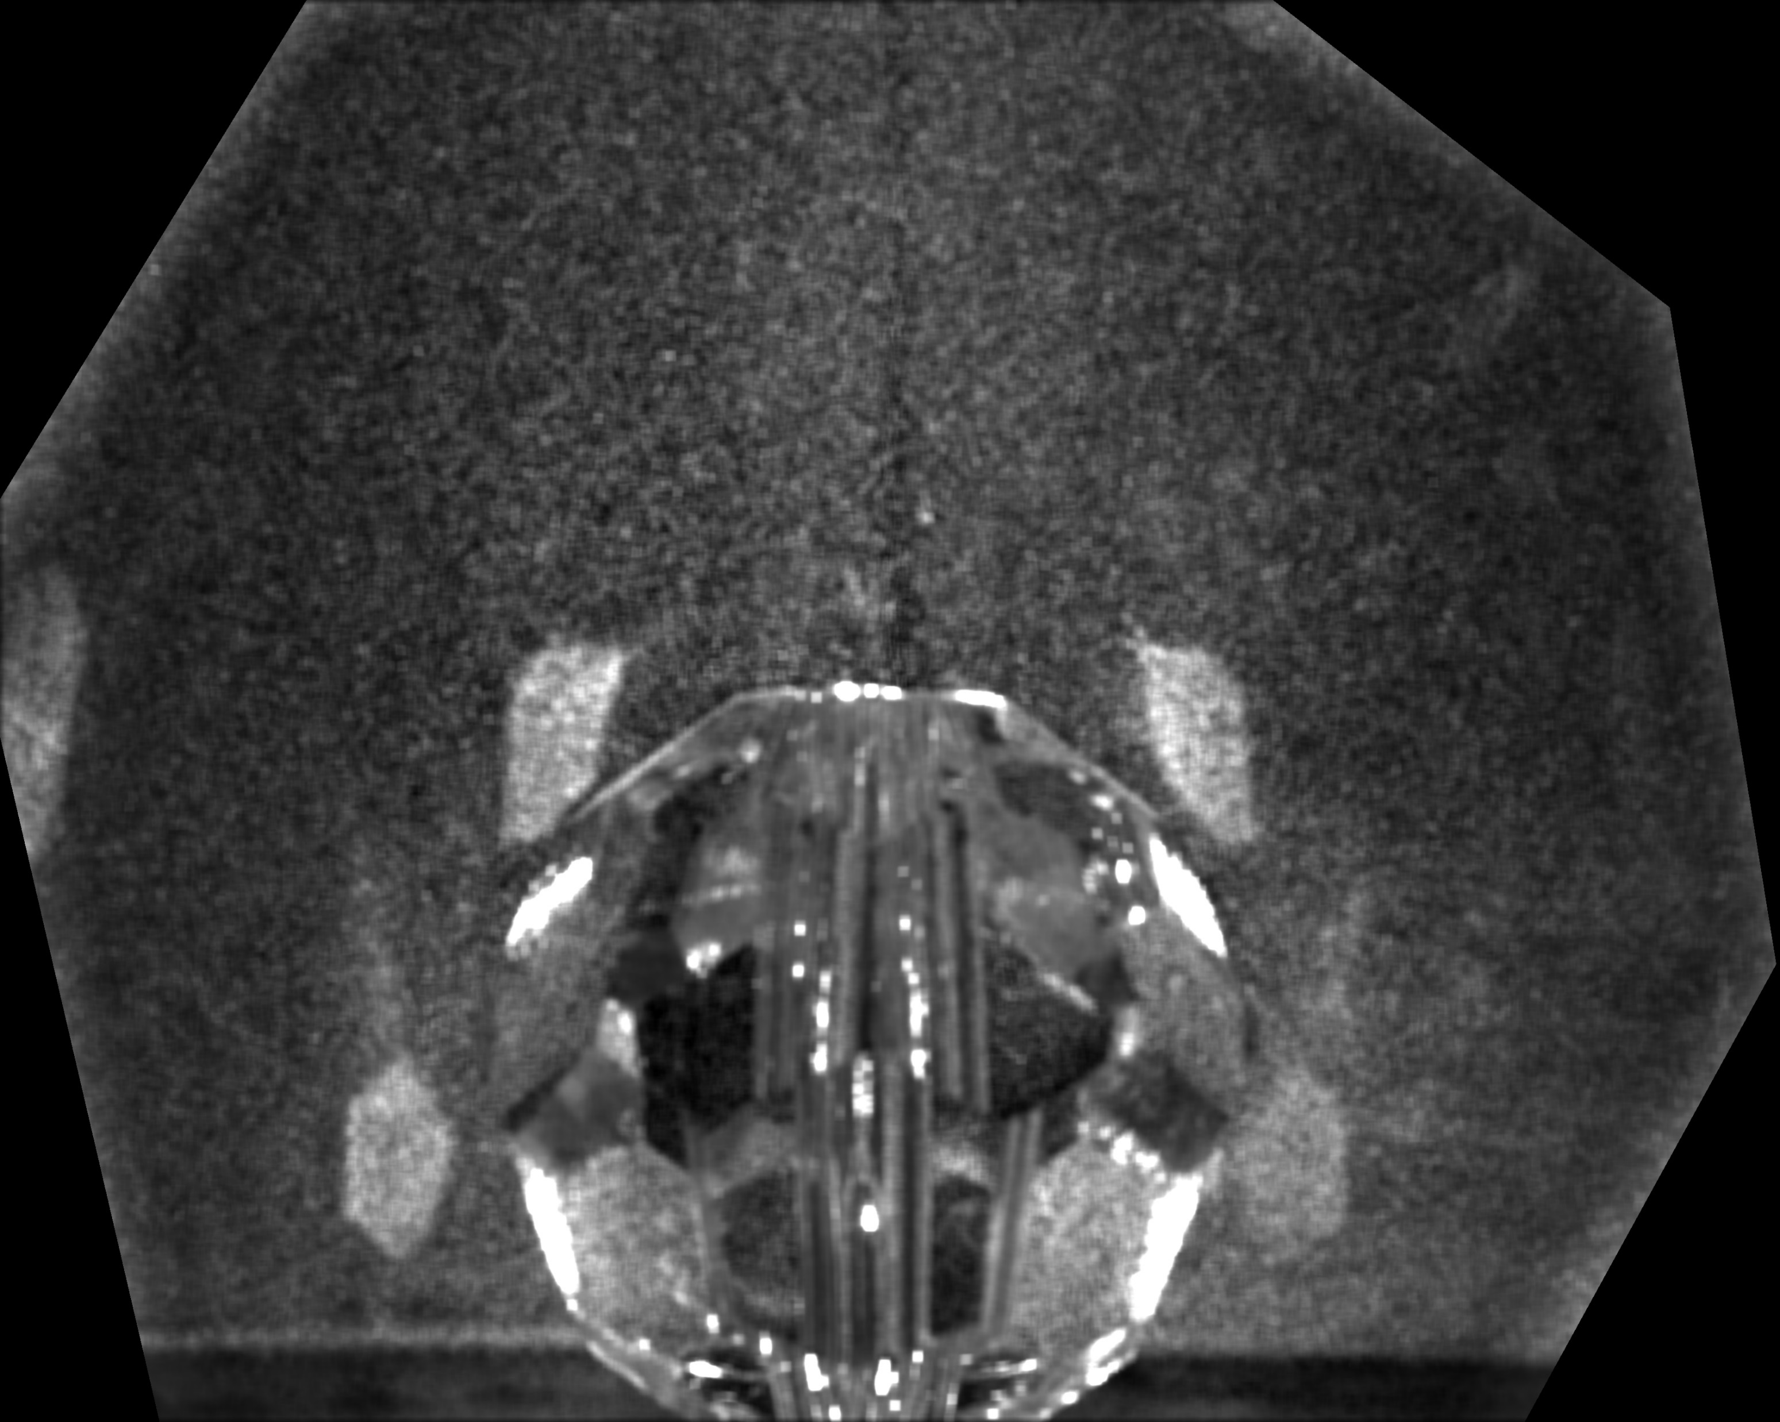
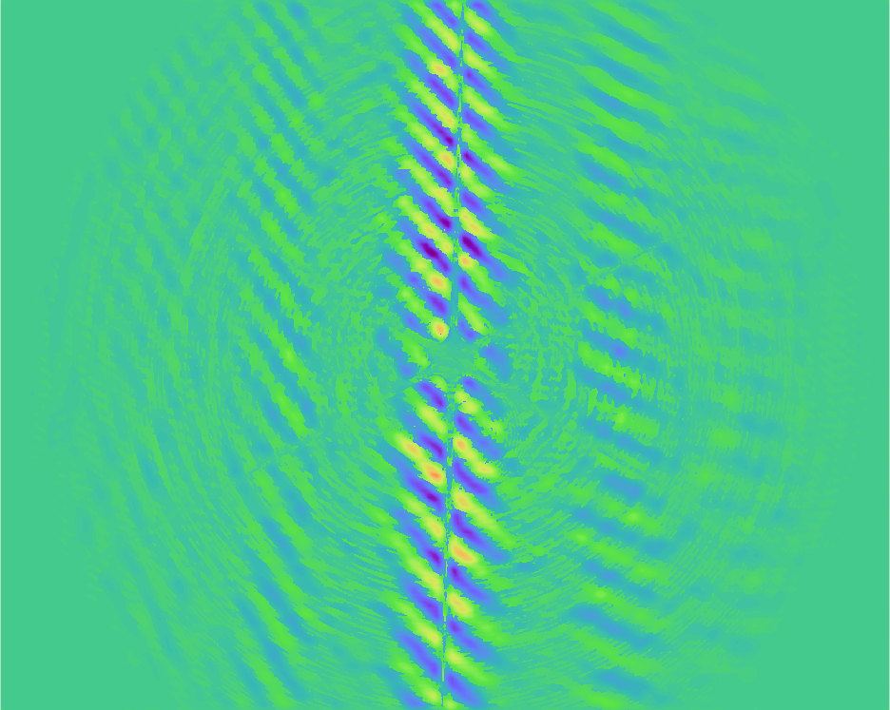
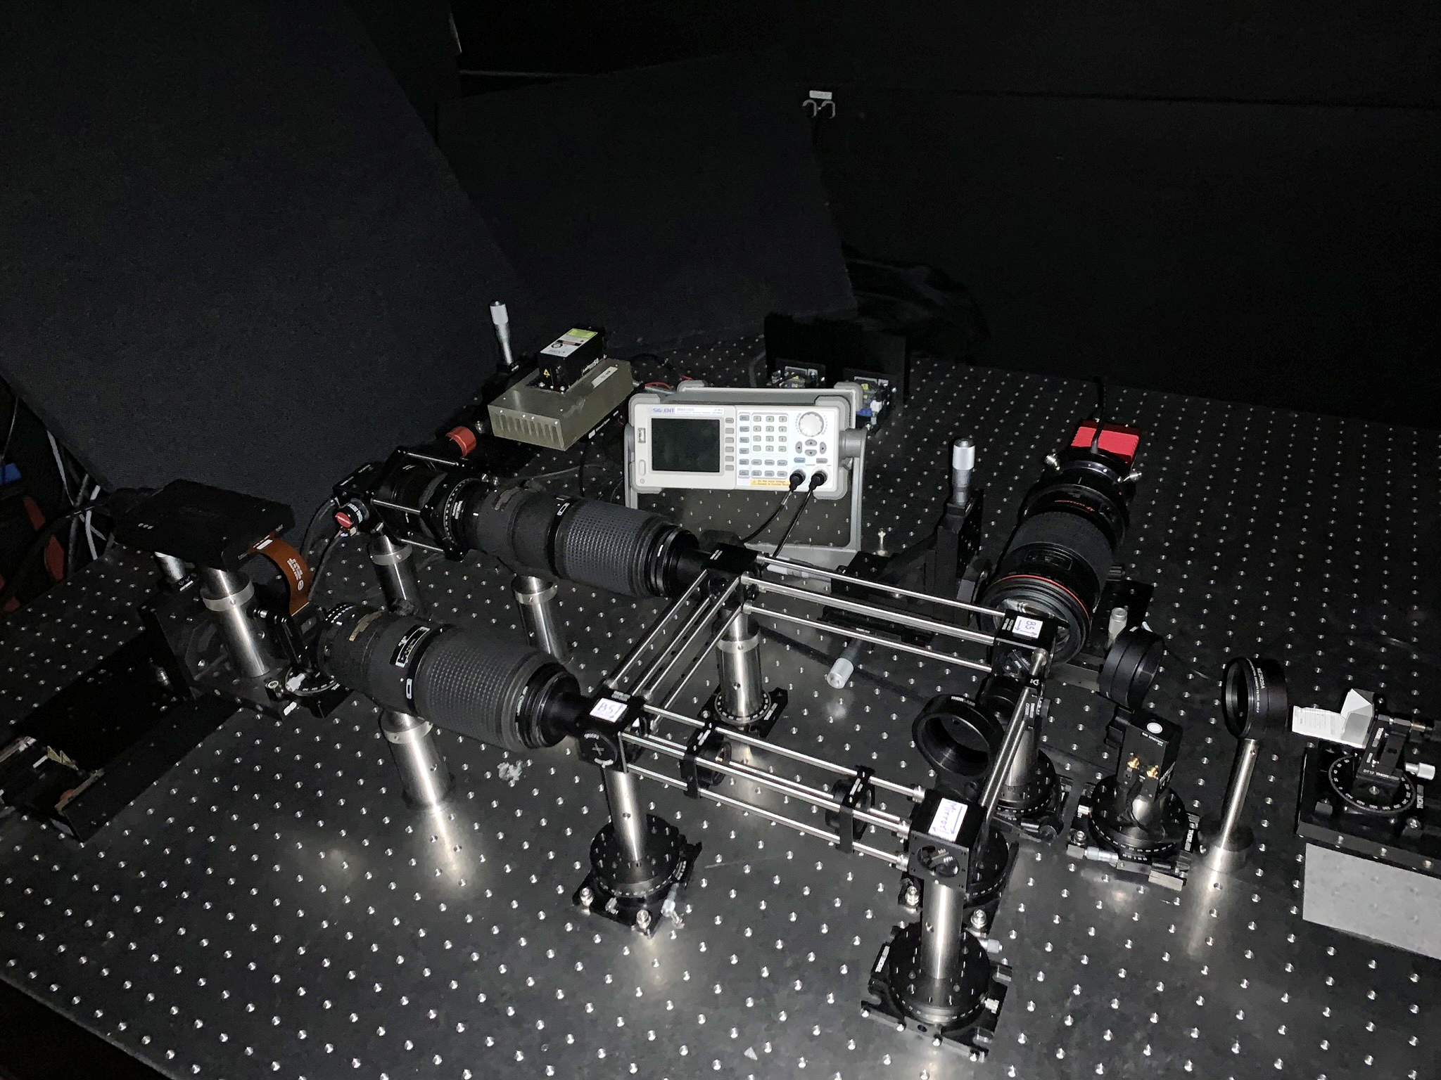
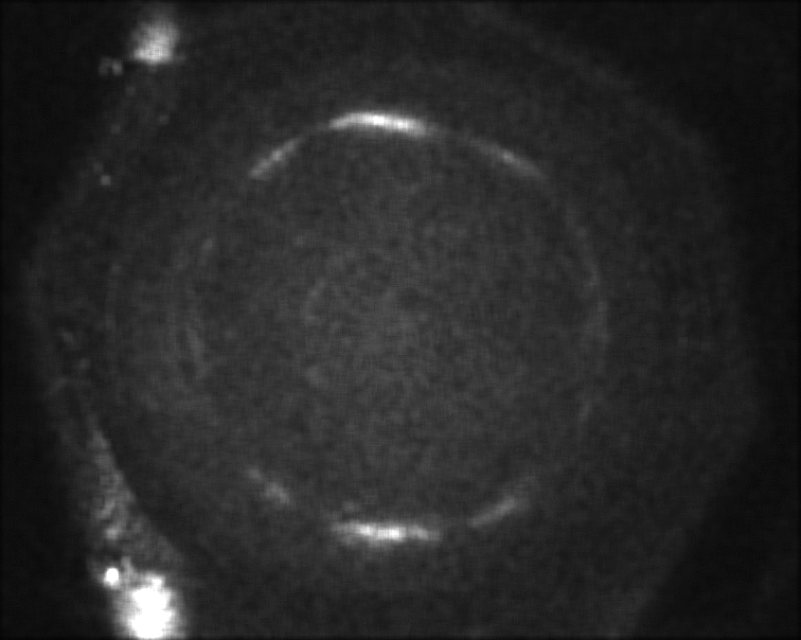
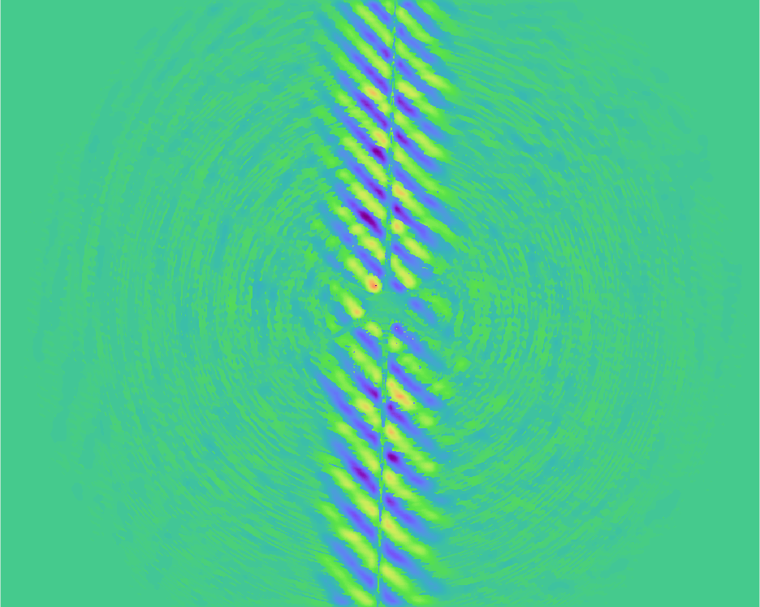




Contributions
probing with
mutual intensity
creating arbitrary
mutual intensity
light-efficient
implementation
probing experiments
coherent probing
$$θ$$
$$A(θ)$$
$$A(θ)$$
$$ℱ$$
camera
Notes:
To this end, I will start with our main theoretical contributions: I will explain how an interferometer can probe light transport with patterns derived from the light source’s mutual intensity properties,
[C] and show how to create a light source that has any desired mutual intensity properties.
[C] I will then walk you through a light-efficient optical setup we built to implement our probing technique,
[C] and present several experiments we did with this setup.
[C] Finally, I will discuss how to use our technique to probe coherent light waves.

Slide 9
Probing with mutual intensity
Notes:
Let’s start with the first part.

Slide 10
The Michelson interferometer
reference mirror
beam splitter
light
monochromatic
source
scene
camera
Notes:
I will start with some preliminaries about interferometry, which is the basis of our technique. I will visualize everything in 2D for simplicity, but please note that our technique works in 3D.
We use an instrument called the Michelson interferometer, shown here.
We take a collimated and monochromatic light source,
[C] and shoot its beam into a beam splitter,
[C] that splits light 50:50, into two ‘arms’
[C] One leads into a reference mirror,
[C] and the other leads into the scene we want to image. Light interacts with this scene, before backreflecting towards the camera, where it is superimposed with light from the reference arm.

Slide 11
The Michelson interferometer
reference mirror
beam splitter
scene:
mirror
light
camera
Notes:
For simplicity, let’s see what happens when the scene is a mirror.

Slide 12
The Michelson interferometer
reference mirror
beam splitter
scene:
mirror
light
camera
scene-only
Notes:
If the camera observed only the scene, it would capture an image of constant intensity.

Slide 13
The Michelson interferometer
reference mirror
beam splitter
scene:
mirror
light
camera
reference-only
Notes:
Likewise, if it observed only the reference.

Slide 14
The Michelson interferometer
reference mirror
beam splitter
scene:
mirror
light
+
camera
scene-only
reference-only
scene +
reference
interference
Notes:
When the camera observes both arms at the same time, we would expect these intensities to add up. However, the wave nature of light causes the measured image to include another component, called
[C] the interference between the waves reflected at the scene and reference.
In our example, this interference takes the form of black and white stripes we call fringes.
Our system measures this interference component by subtracting from the full image the scene-only and reference-only measurements. As I’ll show, the interference equals the probing measurement we want to capture.
[C] Before explaining more about probing, though, let’s first see how we can model the scene-only image formation process.

Slide 15




Scene-only image formation
beam splitter
light
$$s$$
source pixels
 |  |  | $$I_{c,s}$$
scene
light transport matrix
$$I_{c,s}$$
camera pixels
camera
$$c$$
Notes:
For this, let’s discretize points on the source and camera.
We can consider pairwise contributions of source points to camera pixels: For example, when we turn on only source point s, the camera pixel c measures intensity I_c,s.
[C] We can stack up these pairwise contributions in a scene-specific light transport matrix. The number I_c,s is an element of this matrix, placed at the position corresponding to its source point-camera pixel pair.

Slide 16



Scene-only image formation
$$I_{c}$$
 |  |  | $$I_{c,s}$$
1
1
1
1
1
1
1
1
$$=$$
scene-only image
light transport matrix
added up
Notes:
When the entire source is on, the image on the camera is all these pairwise contributions added up at each pixel, which we can express as multiplying the light transport matrix with a vector of ones.

Slide 17
Interference image formation
reference mirror
beam splitter
scene =
mirror
light
+
+
camera
scene
reference
scene +
reference
interference
Notes:
With this context in mind, let’s now look at how to model the interference component.

Slide 18





Interference image formation
reference mirror
beam splitter
$$s^{′}=c$$
light
$$s$$
scene
$$c$$
scene-only: $I_{c,s}$
camera
interference: $α_{c,s}I_{c,s}$
Notes:
Let us examine the contribution of the red path through the scene, starting at source point s, to the interference component at camera pixel c. In the scene-only image, this path created some intensity I_c,s.
[c] The red path interferes with a green path reflecting on the reference mirror.
[c] The contribution from the superposition of these two paths to the interference image equals the intensity I, scaled by a factor alpha. As I’ll show soon, this scale factor is a property of the light source we use, and is defined for all pairs of points on the source.

Slide 19



Light transport probing
 |  |  | $$I_{c,s}$$
 |  |  | $$α_{c,s}$$
1
1
1
1
1
1
1
1
$$=$$
○
interference
image
light transport matrix
probing matrix
adding
up
Notes:
We can then write down pairwise contributions to the interference image as the Hadamard product of the light transport matrix and a matrix formed from all these scaling factors.
[C] As before, to calculate the total interference image, we multiply this matrix by a vector of ones.
Therefore, by controlling this scaling matrix, we can selectively probe certain light paths and cancel others, based on their endpoints on the source and sensor.
[C] For this reason, we call this the probing matrix. Let’s now see how its entries are determined.

Slide 20
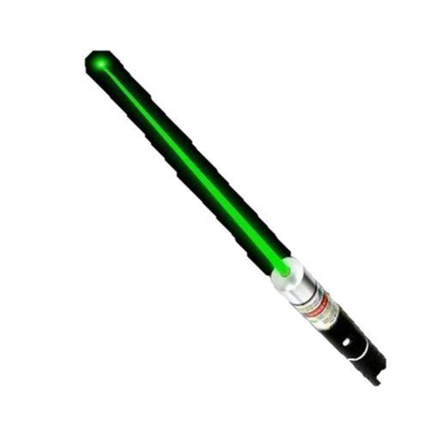
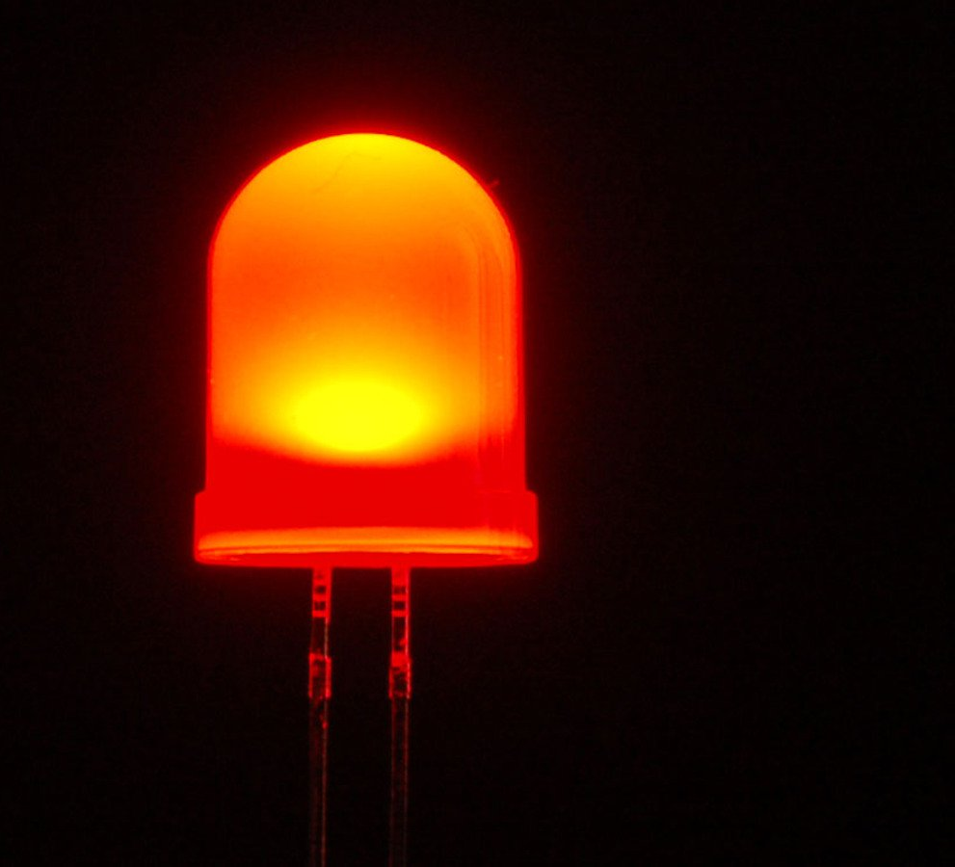






Mutual intensity
$$p_{2}$$
$$p_{2}$$
$$p_{5}$$
↕ 0
$$p_{5}$$
↕ 1
$$p_{8}$$
↕ 0
point
laser
$$p_{8}$$
↕ 1
LED
Notes:
The probing matrix values are related to the mutual intensity of the light source.
This is a wave-optics concept that measures the correlation, or coherence, of waves emitted from different points on the source.
[C] For example, when using an LED, different points on the light source emit light independently. Therefore, the mutual intensity between any two distinct points is zero.
[C] By contrast, when using an expanded laser beam, the waves at different points on the beam are perfectly correlated, and the mutual intensity between any two points is one.

Slide 21
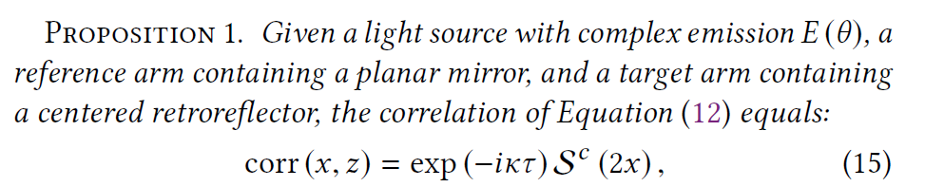
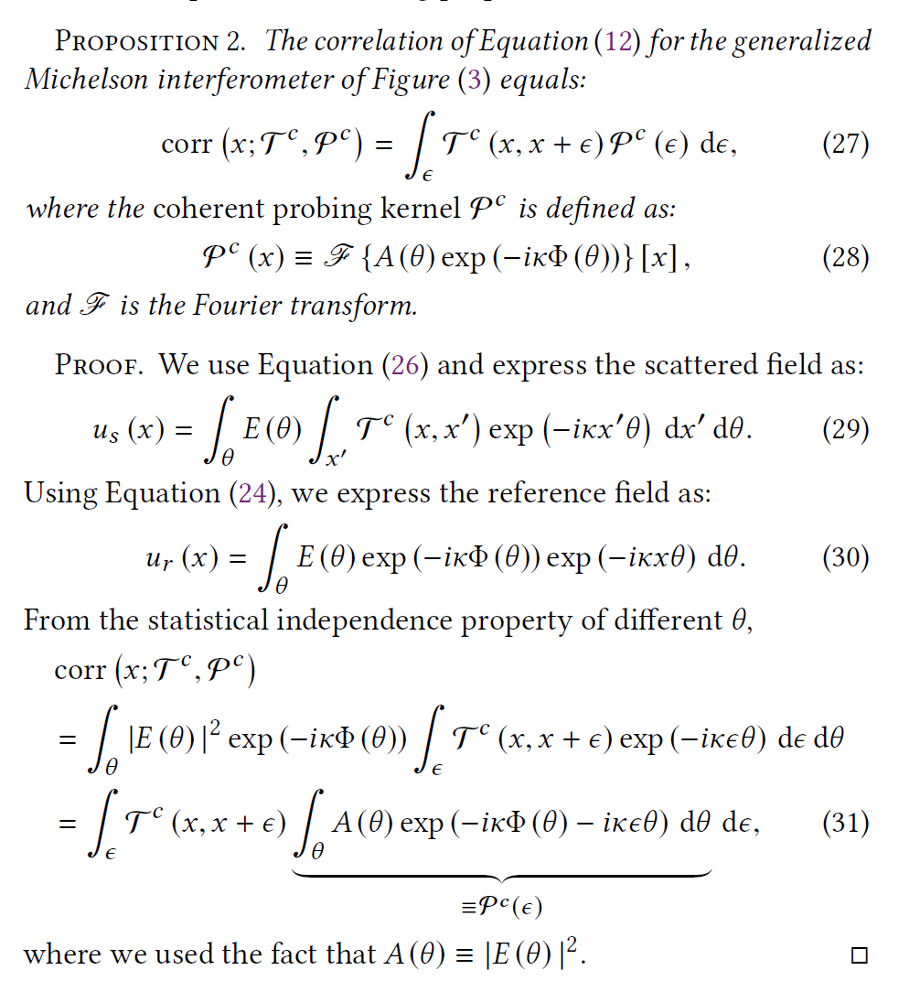
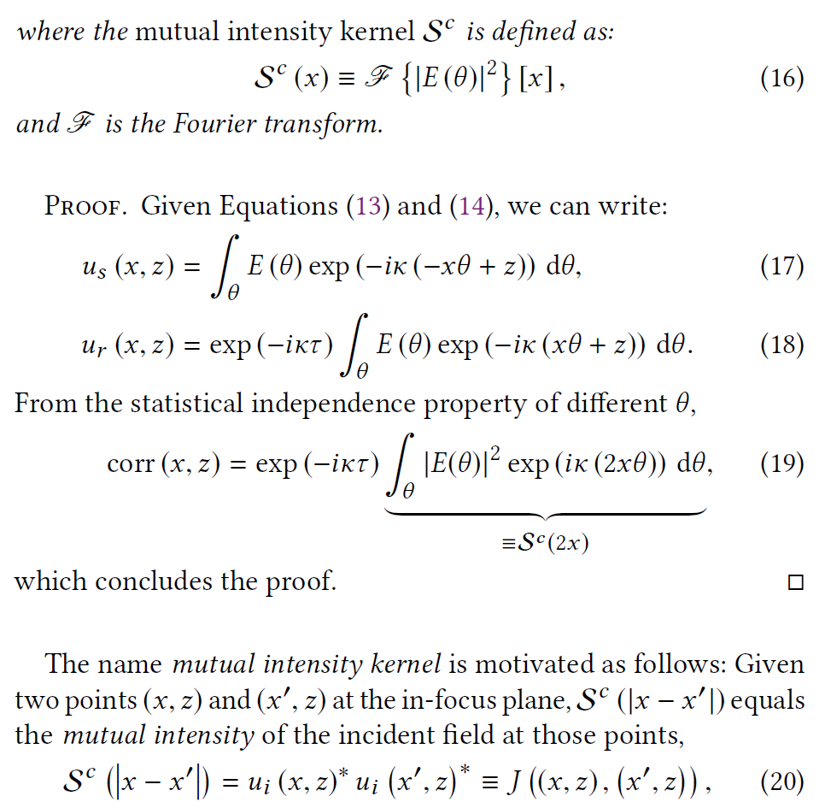










Probing and mutual intensity matrices
○ 2
$$p_{2}$$
$$p_{5}$$
$$p_{8}$$
 | 1 |  |  | 0 |  |  | 1
 | 0 |  |  | 1 |  |  | 0
 | 1 |  |  | 0 |  |  | 1
 |  |  | $$α_{c,s}$$
$$p_{2}$$
$$p_{2}$$
light
$$p_{5}$$
$$p_{8}$$
=
$$p_{5}$$
?
$$p_{8}$$
mutual intensity matrix
probing matrix
Notes:
For any light source, given two points we can compute mutual intensities and arrange them in a matrix, that we call the mutual intensity matrix. The values in this matrix are complex numbers, with amplitudes between 0 and 1.
[C] Our key technical result is to show that, measuring the interference component is equivalent to probing light transport, with a probing matrix equal to the element-wise squared amplitude of the mutual intensity matrix.
[C] I’ve built up this result informally, but in the paper we have a detailed derivation from first principles in Fourier and statistical optics.
[C] Considering this relationship in reverse, given a desired probing matrix, we can implement it by creating a light source whose mutual intensity matrix is the element-wise complex square root of the probing matrix.
[C] The question then becomes, how do we create such a source?

Slide 22
Source design
Notes:
This brings us to the next part of the talk.

Slide 23

Creating the source
?
$$→$$
mutual intensity matrix
Notes:
I will show how to do this design for the specific case when the desired probing and mutual intensity matrices are Toeplitz.
[C] This means that each row is a shifted version of a pattern that we call the generator of the matrix.

Slide 24



Creating the source
mutual intensity matrix
?
$$→$$
$$x$$
$$W(x)$$
$$x$$
Notes:
The generator will determine how to decide the source we use in our interferometric system.

Slide 25

Creating the source
$$f$$
Notes:
Sources in interferometry are typically created by placing a point emitter in the focal plane of a lens.

Slide 26
Creating the source
$$f$$
Notes:
Instead, we create the source by placing an area emitter, with a controllable emission amplitude profile, behind the lens.

Slide 27





Creating the source
$$f$$
mutual intensity matrix
$$θ$$
$$A(θ)$$
$$x$$
Fourier transform
$$W(x)$$
$$↔$$
$$ℱ$$
$$θ$$
Notes:
Let us plot the amplitude profile of the source.
[C] What we show in the paper is that this profile and the generator of the source’s mutual intensity matrix are related by a Fourier transform.
Therefore, given any Toeplitz probing matrix, we can create the required source by extracting its generator and implementing the Fourier transform of its elementwise square root on the source.

Slide 28


Point source mutual intensity
1 | 1 | 1 | 1 | 1 | 1 | 1 | 1
1 | 1 | 1 | 1 | 1 | 1 | 1 | 1
1 | 1 | 1 | 1 | 1 | 1 | 1 | 1
1 | 1 | 1 | 1 | 1 | 1 | 1 | 1
1 | 1 | 1 | 1 | 1 | 1 | 1 | 1
1 | 1 | 1 | 1 | 1 | 1 | 1 | 1
1 | 1 | 1 | 1 | 1 | 1 | 1 | 1
1 | 1 | 1 | 1 | 1 | 1 | 1 | 1
$$A\left(θ\right)=δ(θ)$$
$$→$$
mutual intensity matrix
$$f$$
Notes:
Let’s see some simple examples. Let’s place behind lens a point source, corresponding to a Dirac delta amplitude profile.
Its Fourier transform is the constant generator function, resulting in a mutual intensity matrix that equals one everywhere.
This is equivalent to traditional imaging without probing.

Slide 29
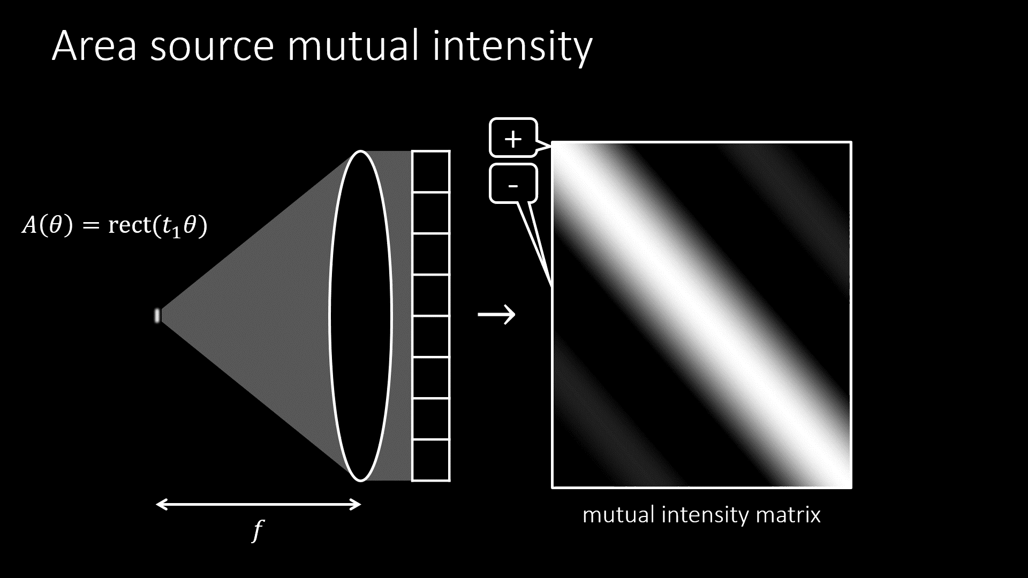
Notes:
Let’s now place behind the lens an area source with constant amplitude.
Through a Fourier transform, the corresponding generator of the mutual intensity matrix is a sinc function.
As the size of the source increases, its Fourier transform becomes increasingly narrow.

Slide 30
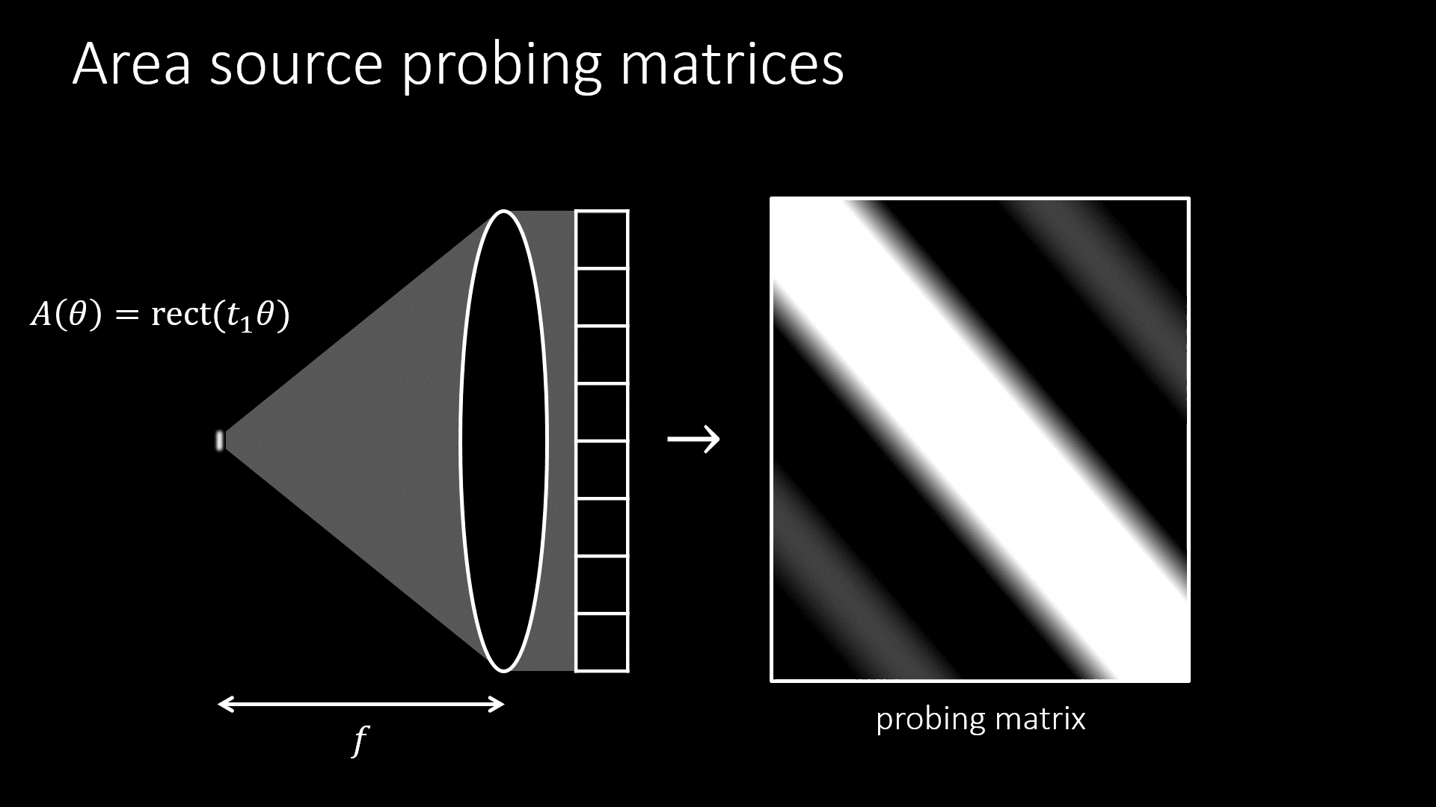
Notes:
These mutual intensity matrices result in probing matrices that are their squared magnitudes.

Slide 31
Implementation
Notes:
Let’s see now how to implement all these in hardware.

Slide 32
Implementing
probing
Notes:
Given a desired Toeplitz probing matrix, we only need to consider its generator.

Slide 33
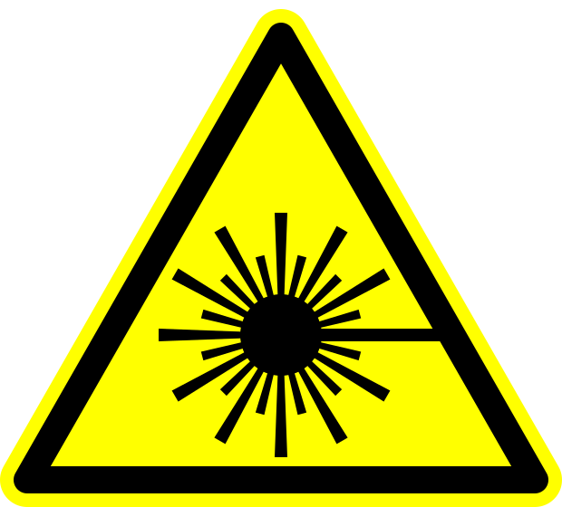


single
frequency
laser
$$ℱ=A\left(θ\right)e^{jφ(θ)}$$
$$θ$$
rotating
mirror
Implementing
probing
Notes:
We compute the Fourier transform of the generator and
[C] separate out the amplitude and phase parts.
[C] We then take a single-frequency laser, which emits monochromatic light
[C] And use a fast-rotating mirror to steer its beam.
[C] Finally, a lens focuses the laser beam in its focal plane. Let us label positions in this plane as \theta.

Slide 34
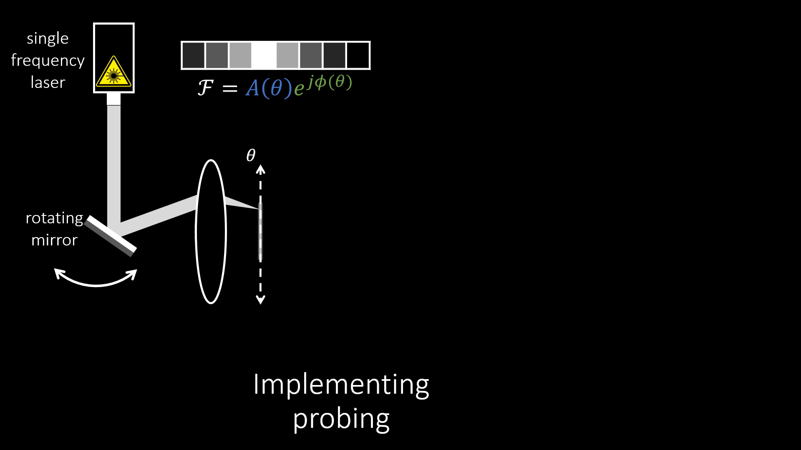
Notes:
As the mirror rotates, the beam gets scanned along the dashed line to form our area source.

Slide 35




single
frequency
laser
$$ℱ=A\left(θ\right)e^{jφ(θ)}$$
amplitude
modulator
$$θ$$
$$A(θ)$$
rotating
mirror
$$f′$$
$$A(θ)$$
Implementing
probing
$$θ$$
Notes:
To modulate the amplitude of this area source, an amplitude modulator is placed between the laser and rotating mirror.

Slide 36
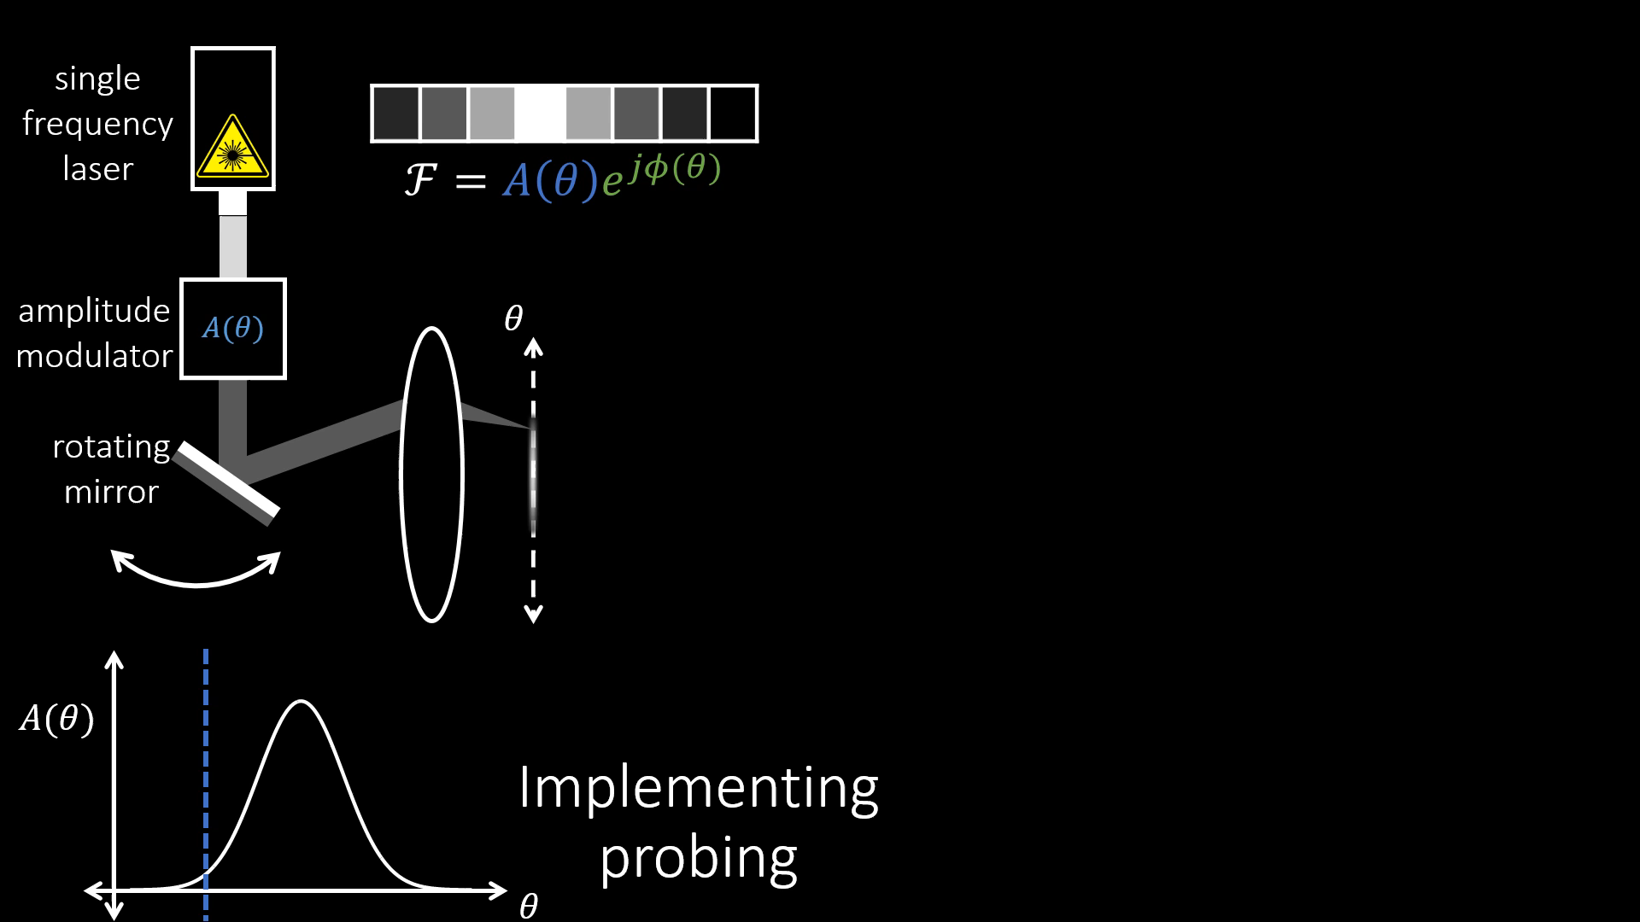
Notes:
This modulator operates in sync with the rotation of the mirror, tracing out the specific amplitude profile we want to create.

Slide 37


reference mirror
single
frequency
laser
$φ(θ)$
$$ℱ=A\left(θ\right)e^{jφ(θ)}$$
amplitude
modulator
$$θ$$
$$A(θ)$$
rotating
mirror
beam
splitter
$$f$$
$$A(θ)$$
camera
Implementing
probing
scene
$$θ$$
Notes:
This area source is then placed in the focal plane of another lens, that injects light into the Michelson interferometer.
Note that the components in the blue box operate at MHz frequencies, which means that the amplitude modulation happens within exposure.
Therefore, the effective source for the rest of the system is an area source.
An important characteristic of our amplitude modulation implementation, which we discuss in detail in the paper, is that it results in high light efficiency for a large class of probing patterns.
[C] Finally, note that the Fourier transform of the generator may have a phase component, which we can implement in the reference arm, as we show in the paper.

Slide 38
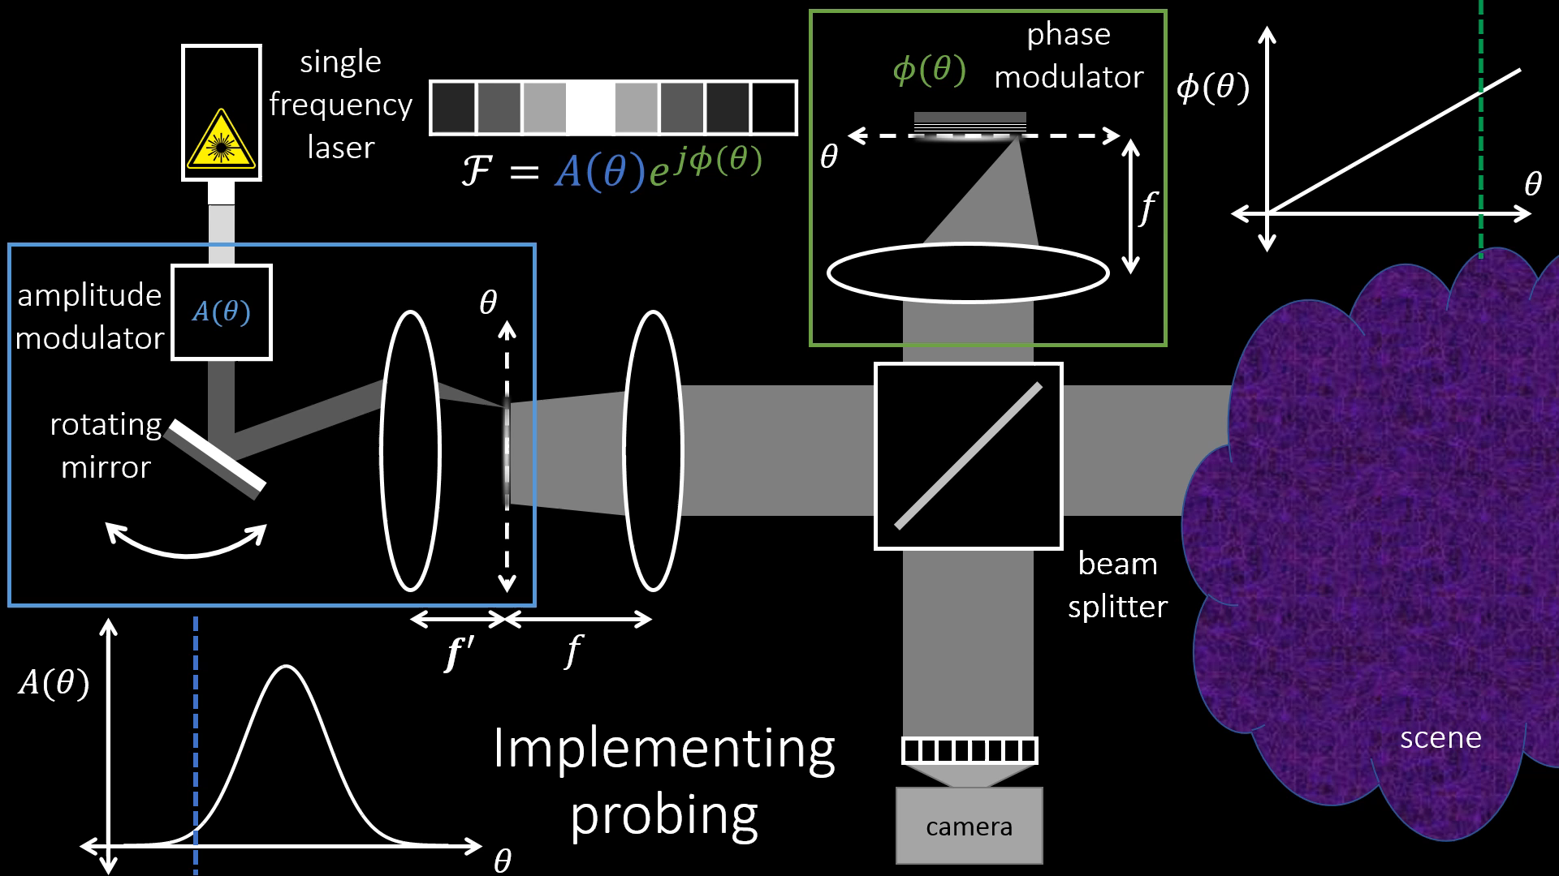
Notes:
Backup slide for phase modulation.

Slide 39


Prototype
$$A(θ)$$
$φ(θ)$
Notes:
Here is a photo of our implementation. The blue and green boxes show the amplitude and phase modulation components that I described in the previous slide.

Slide 40

From 2D to 3D world
camera
plane
$$f$$
illumination
plane
Notes:
So far, I visualized everything in 2D, which meant that my camera and source were 1 dimensional.
However, real sources and cameras are 2-dimensional. This results in a 4-dimensional light transport matrix that is probed by a 4-dimensional Toeplitz probing matrix.

Slide 41



From 2D to 3D world
$$↔$$
$$ℱ$$
source
probing
$$↔$$
$$ℱ$$
source
probing
$$↔$$
$$ℱ$$
$$f$$
illumination
plane
source
probing
Notes:
Everything I’ve shown you generalizes to this setting:
The generators of the probing matrix are now 2-dimensional functions, and we use their Fourier transform as the amplitude profile of a 2-dimensional source.
[C] For instance, a horizontal line source results in a 4-dimensional probing matrix generated by its 2-dimensional Fourier transform, which is a vertical pattern, and likewise for other orientations.

Slide 42
Experiments
Notes:
Let’s now look at some results. I will show a few scenes, demonstrating different types of probing.

Slide 43
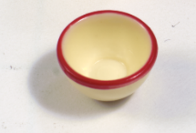
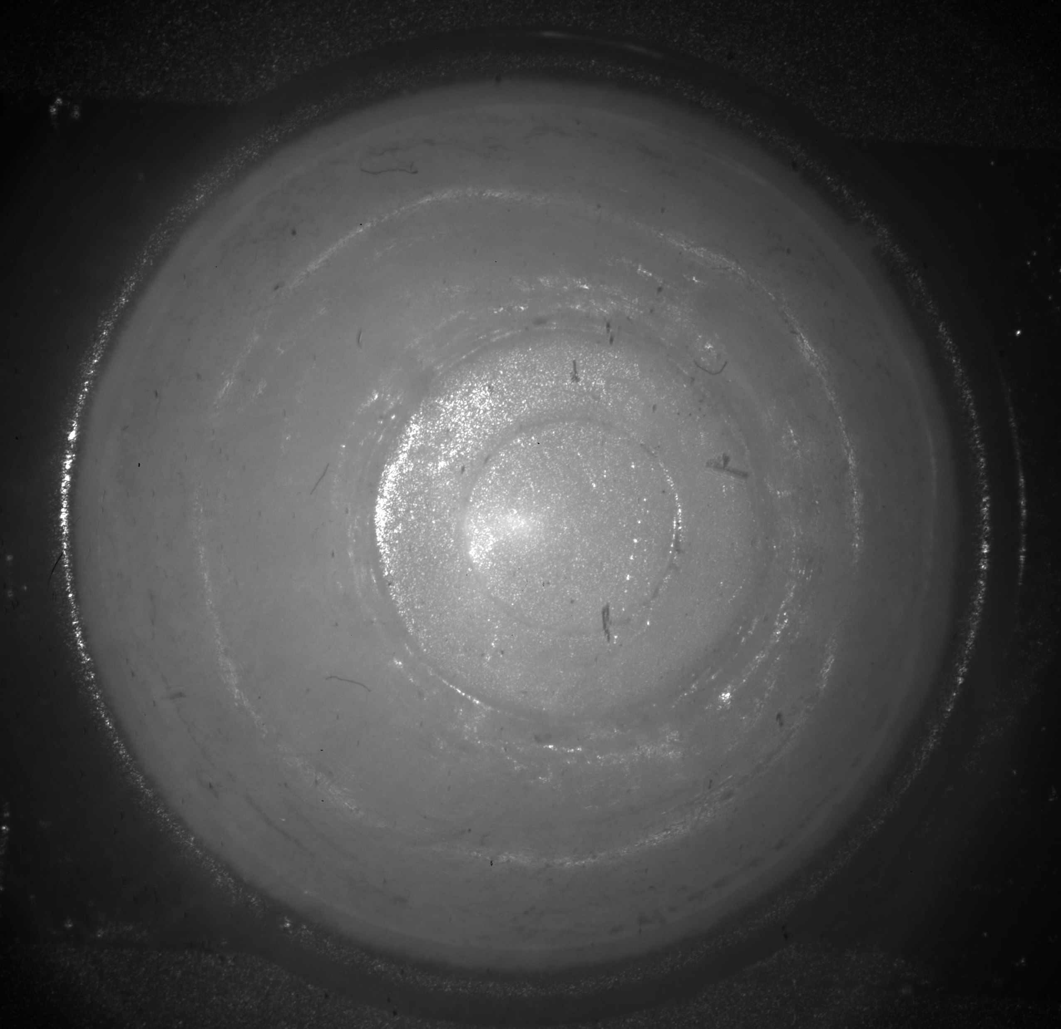
Image formation: cup scene
direct
+
subsurface
scattering
=
+
specular
reflections
+
scene-only image
interreflections
Notes:
Consider first a scene consisting of a plastic toy cup, about a centimeter in size, shown on the top left.
Light travels in this scene in a variety of ways. For instance, there are the so-called
[C] direct paths, where light reflects once on the cup surface.
[C] There are subsurface-scattering paths, where light bounces inside the cup.
[C] There are also paths due to specular and other inter-reflections on the surface of the cup.
[C] Adding all these up produces the image we’d seen from a traditional camera.

Slide 44

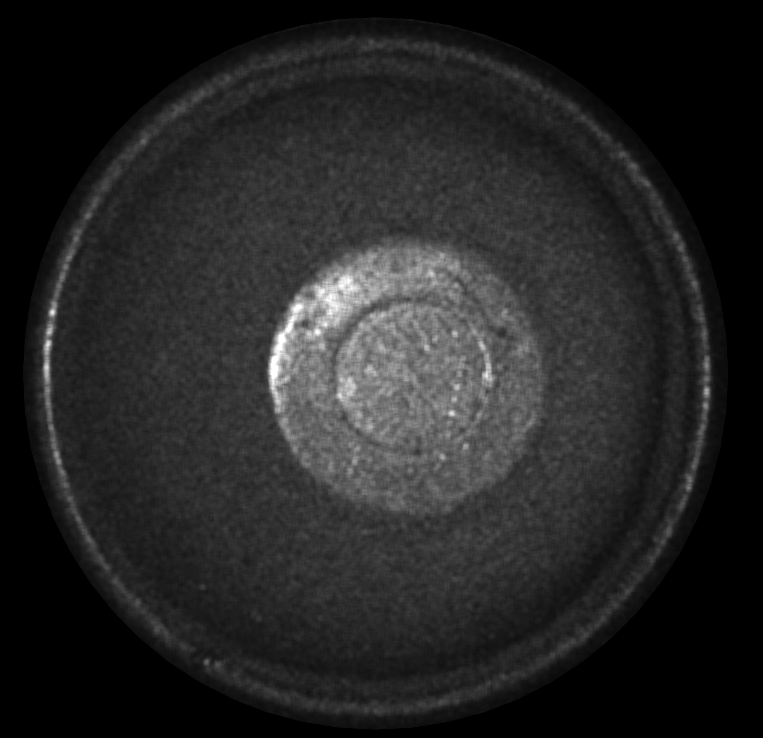
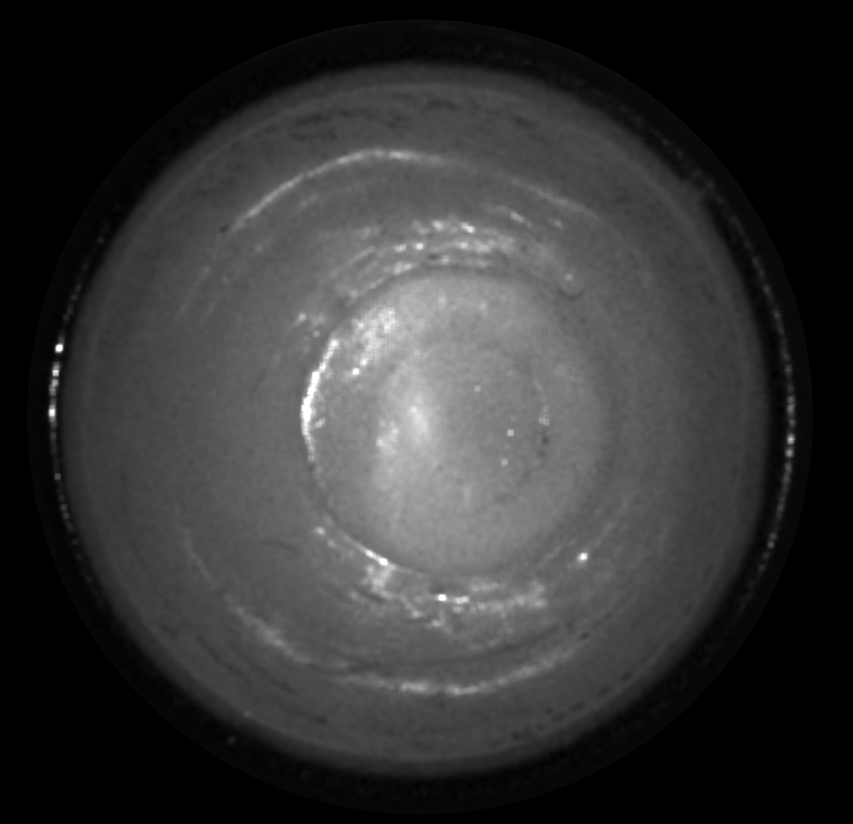

direct-global separation
$$↔$$
$$ℱ$$
direct-only
global-only
source
probing
Notes:
We can use our probing technique to isolate only the direct, orange paths, or all paths corresponding to global effects from interreflections and scattering.
The direct-only component of the cup looks metallic, as all of the subsurface scattering that gives the cup its color has been removed.
By contrast, the global component maintains this color, along with the interreflections.

Slide 45
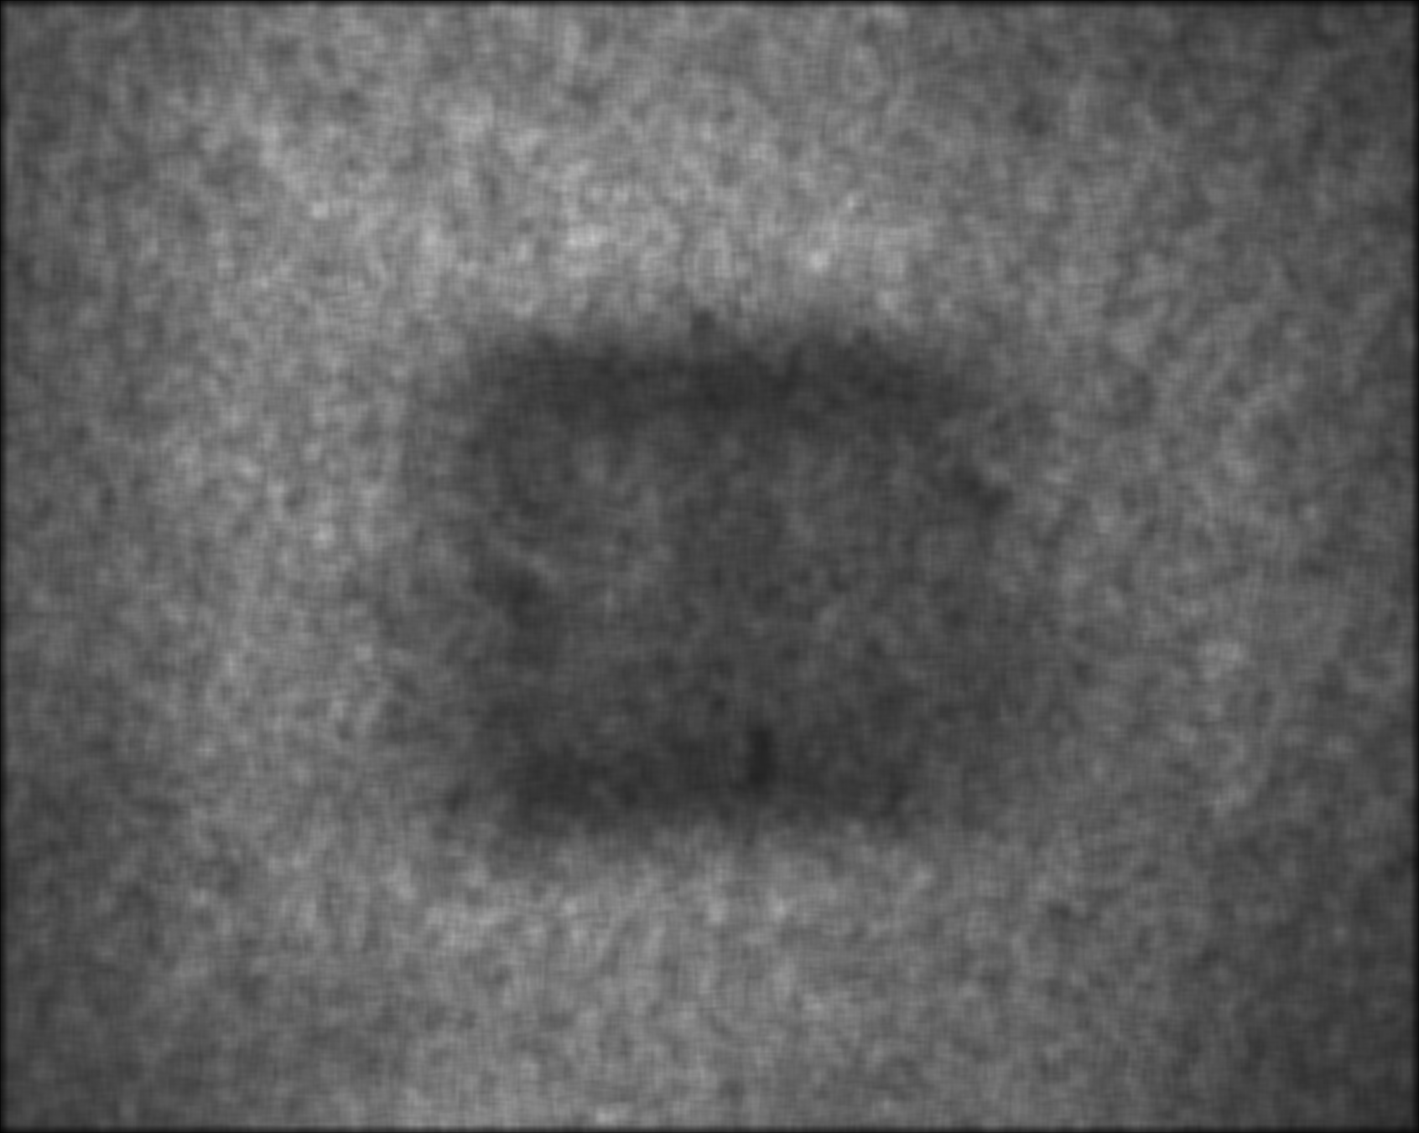


Anisotropic filtering
$$↔$$
$$ℱ$$
$$↔$$
$$ℱ$$
scene
source
probing
source
probing
hidden template
Notes:
Returning to the example of a template behind a tissue phantom, we can use probing with anisotropic patterns to optically enhance features of different orientations in the template.
[C] For example, probing with a vertical pattern optically sharpens the white vertical edges,
[C] whereas probing with a horizontal pattern emphasizes the black horizontal edges.
Effectively, probing works as optical matched filtering.

Slide 46
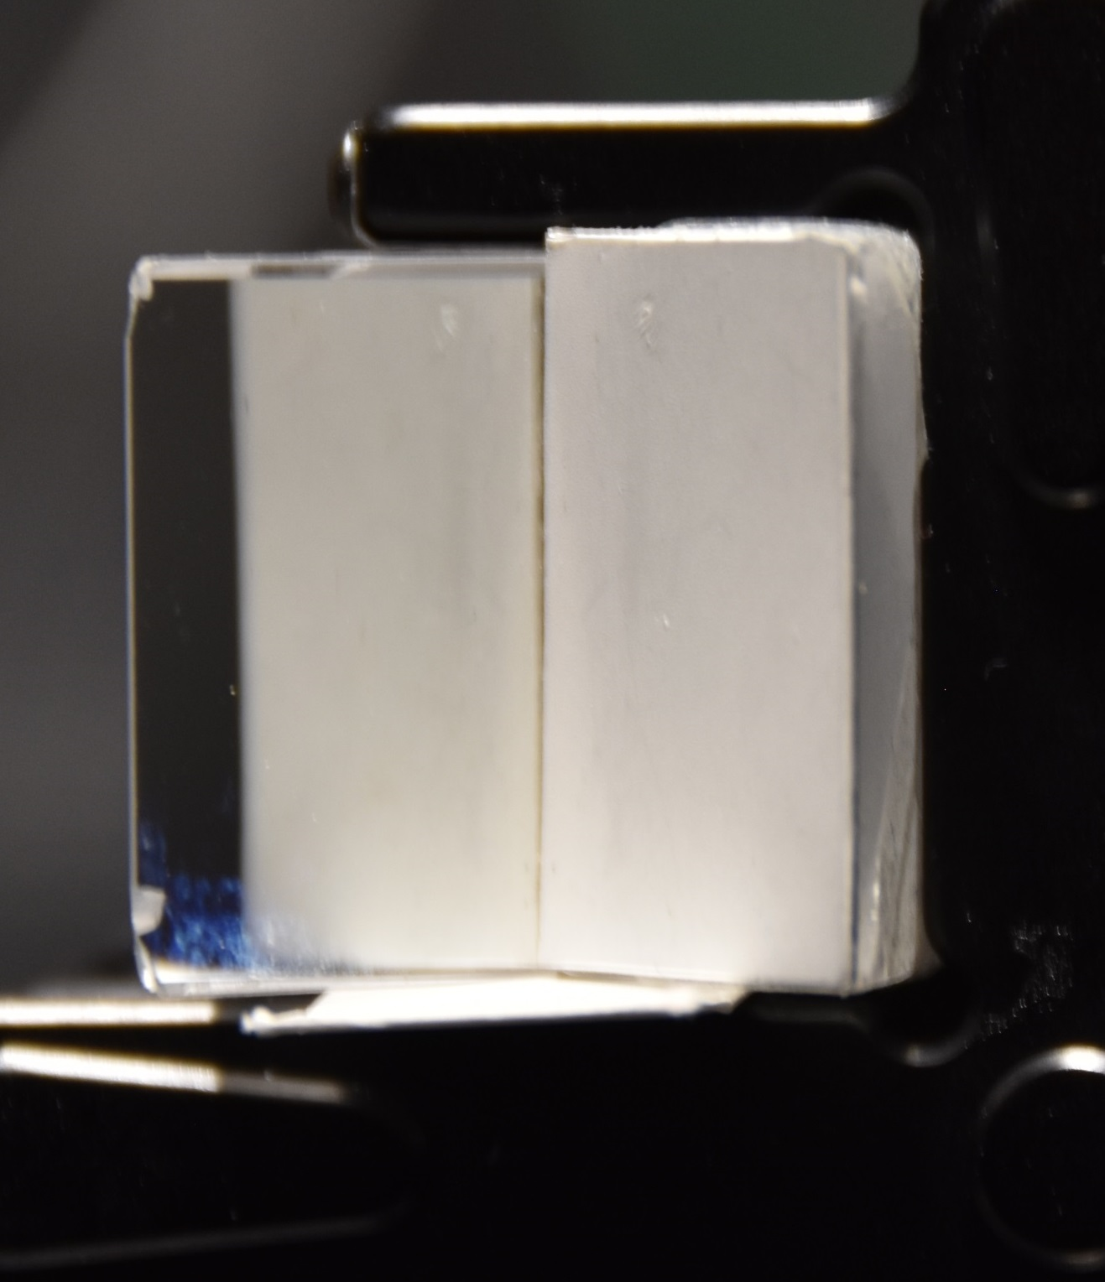
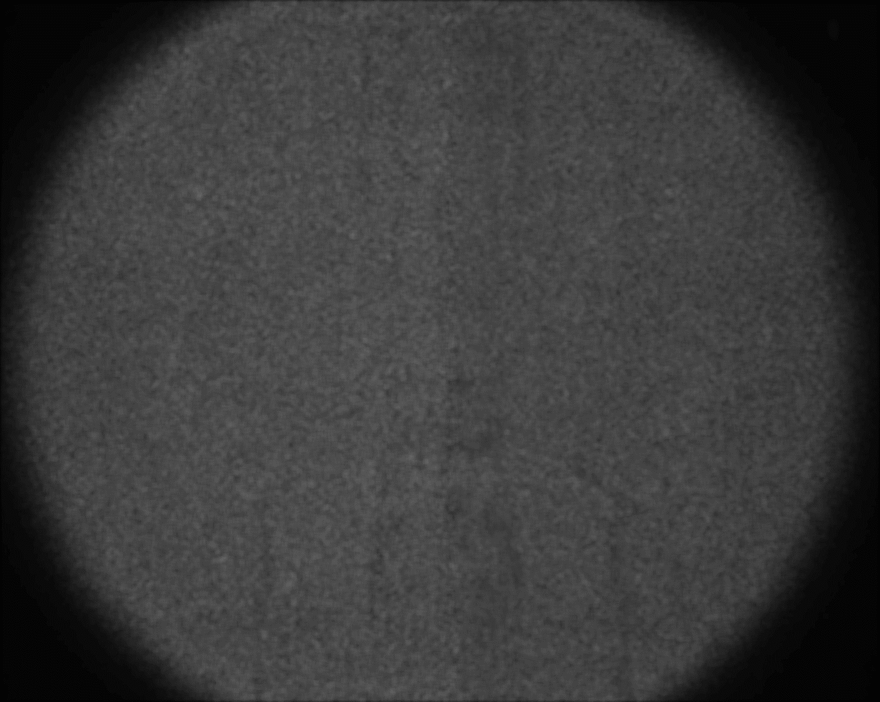
Indirect light transport
off-
diagonal
mirror
diagonal
off-
diagonal
=
diagonal
scene-only image
diffuser
Notes:
This is a scene where a mirror and a diffuser are placed at a right angle.
[C] The light transport matrix of this scene has a diagonal component corresponding to the direct paths shown in orange, and three-bounce retroreflecting paths shown in blue.
[C] The off-diagonal parts of the matrix, on the other hand, capture the two-bounce reflective paths shown in green.

Slide 47
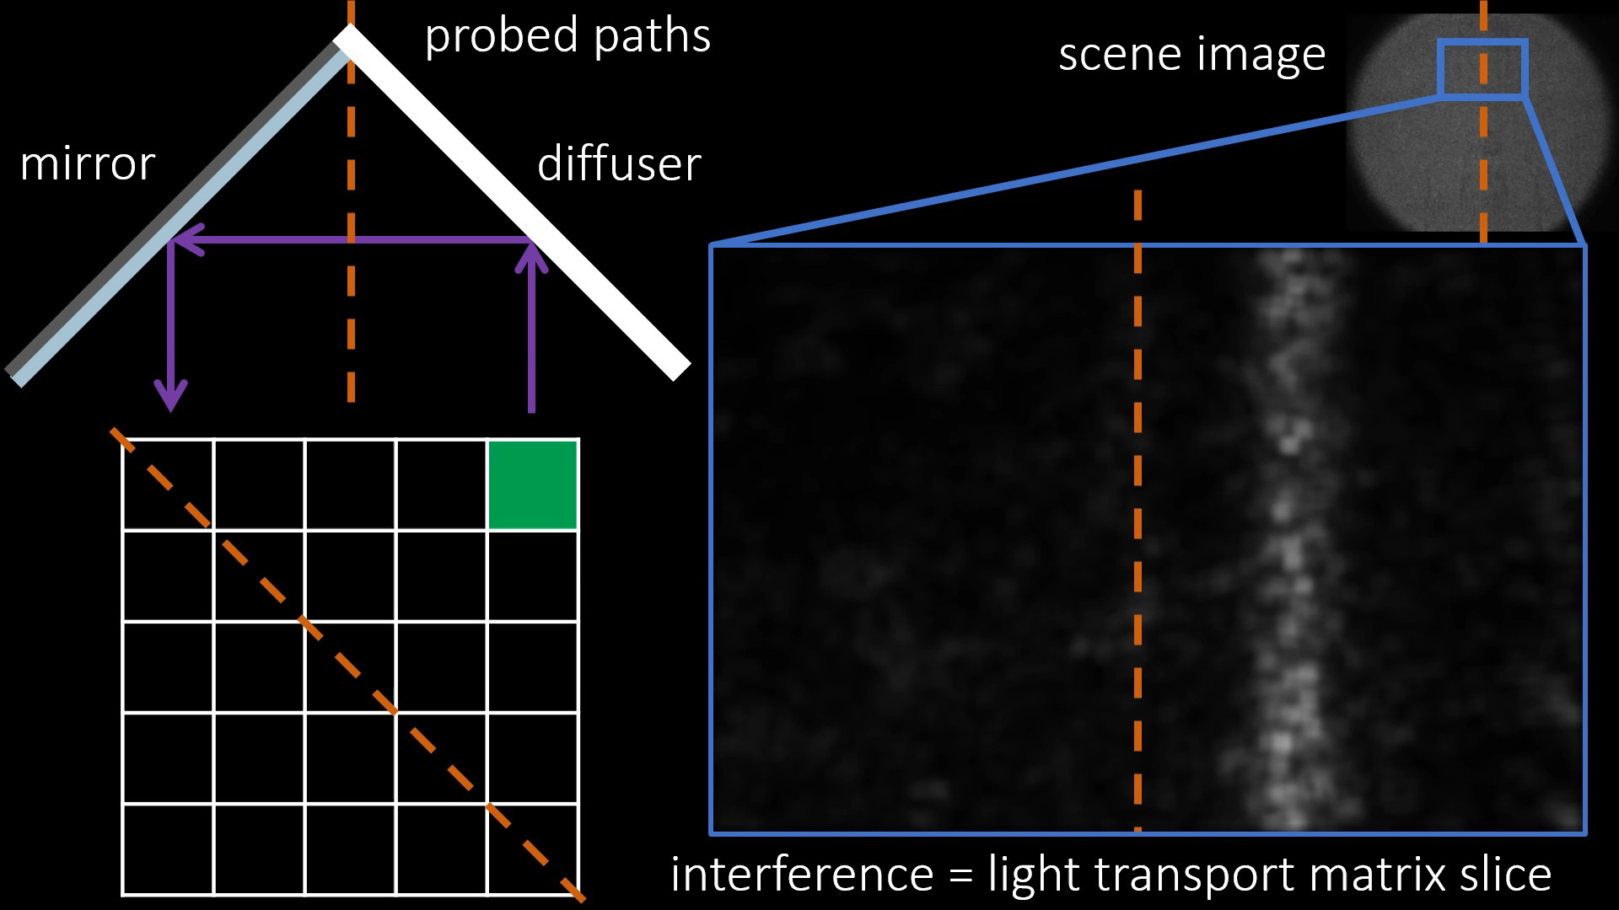

Indirect light transport
Notes:
We can separately measure the main and off-diagonals of the matrix, by manipulating the phase part of the Fourier transform. We show the frames corresponding to each diagonal, as well as the corresponding measured light transport matrix.

Slide 48
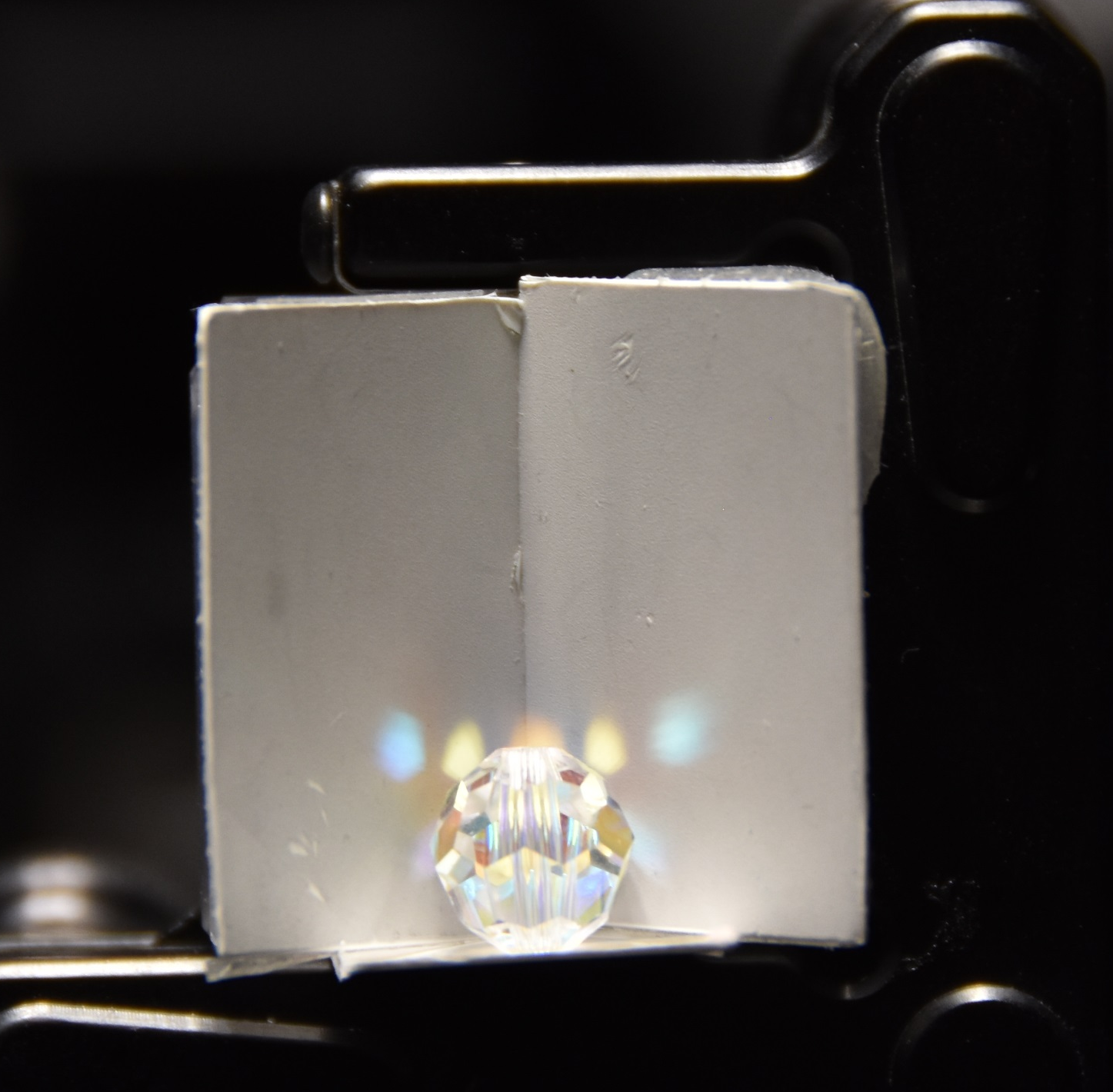
Bead and diffuse walls
diffuser
‘direct’
+
‘wall-wall
reflection’
+
=
‘bead-wall-reflection’
+
‘wall-bead-
reflection’
scene-only image
diffuser
Notes:
This is a scene containing a glass bead between two diffuse walls.
[C] Different paths in this scene include direct paths,
[C] wall-wall interreflections
[C] and specular reflections on the bead and diffuse wall

Slide 49



direct-global separation
direct-only
global-only
$$↔$$
$$ℱ$$
source
probing
Notes:
As before, we can use probing to form direct-only and global-only images.
In this case, the global-only component includes all the caustics formed on the diffusers and beads.

Slide 50
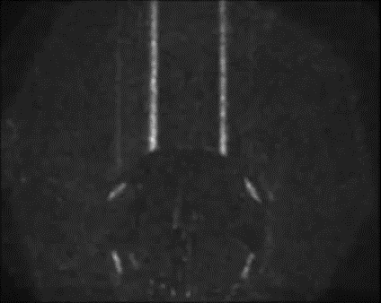
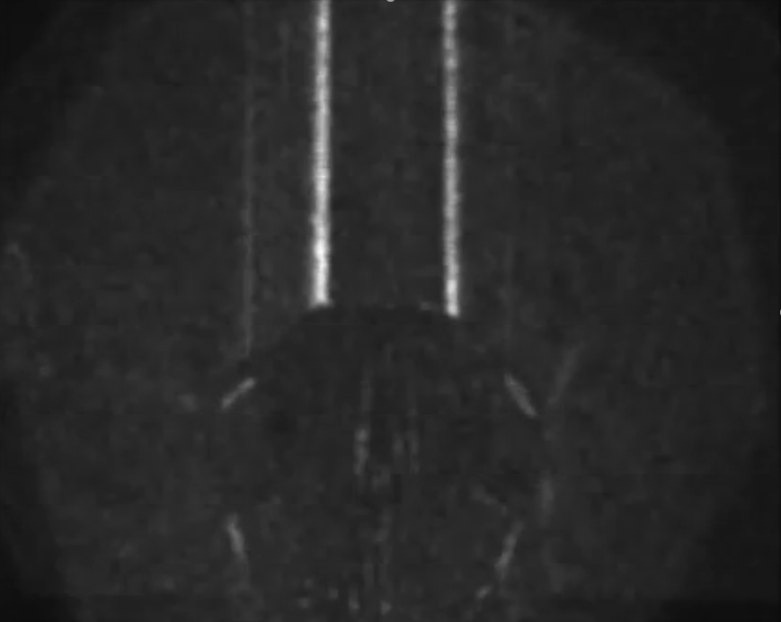
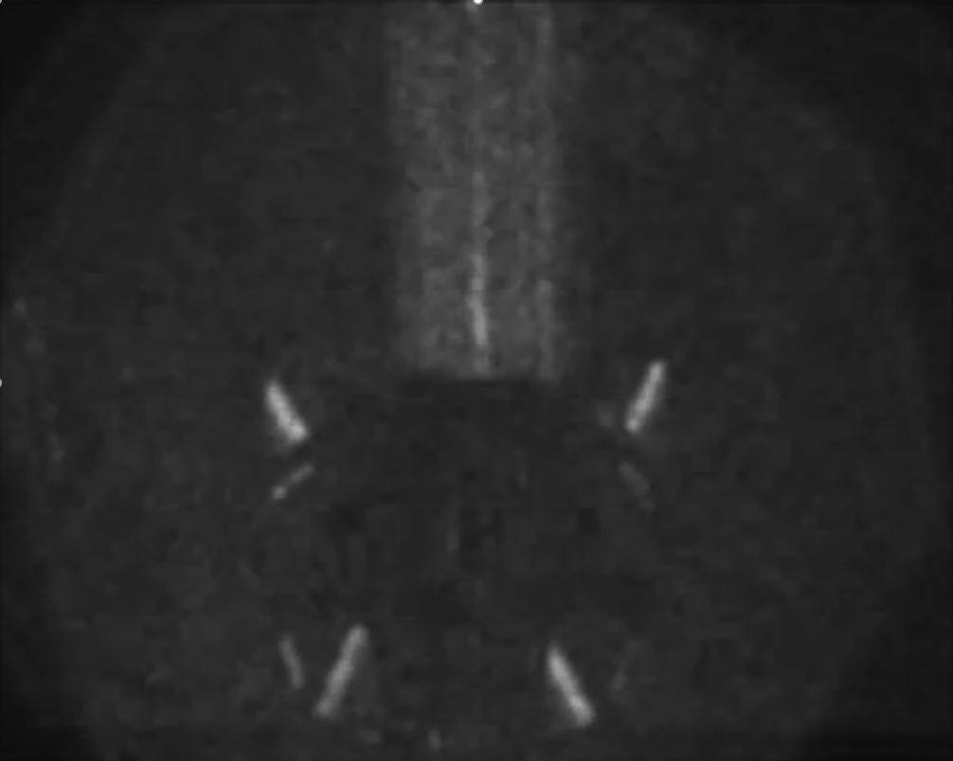
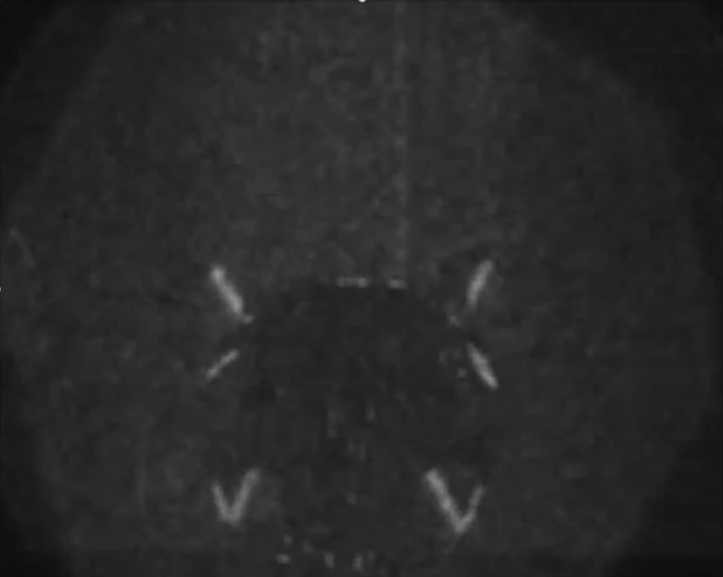







transient images and probing
diffuser
$$t_{3}$$
$$t_{1}$$
$$t_{1}$$
$$t_{2}$$
$$t_{3}$$
$$t_{3}$$
$$t_{2}$$
diffuser
Notes:
This scene provides us a good opportunity to show how our probing technique can be combined with transient imaging.
In this scene, different light paths have different times of light.
[C] Using transient imaging, we can capture a video of this scene where paths of different times of flight appear at different frames.

Slide 51
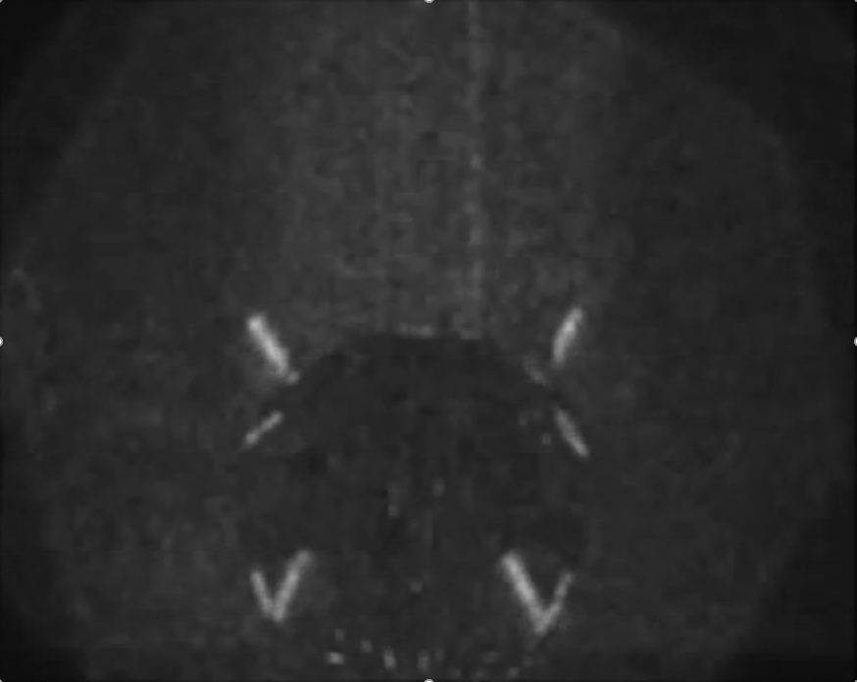

broadband
laser
moving mirror
$$θ$$
beam
splitter
static
mirror
$$t$$
$$f′$$
$$f$$
camera
optical coherence tomography
Notes:
To perform transient imaging in a small scene such as this, we need to use optical coherence tomography.
This technique uses a Michelson interferometer setup similar to ours: the single-frequency laser now becomes a broadband laser, and the reference mirror is placed on a translation stage.
[C] As the reference mirror translates, the interference component captures different frames in the transient sequence.

Slide 52
moving reference mirror
broadband
laser
$$ℱ=A\left(θ\right)e^{jφ(θ)}$$
amplitude
modulator
$$θ$$
$$A(θ)$$
rotating
mirror
beam
splitter
$$f$$
$$A(θ)$$
camera
Implementing
probing
scene
$$θ$$
Notes:
It is now straightforward to incorporate our probing into this system: we reintroduce the rotating mirror and the amplitude modulator, so the source in the focal plane is an area source with a controllable amplitude profile, implementing the desired probing matrix.

Slide 53
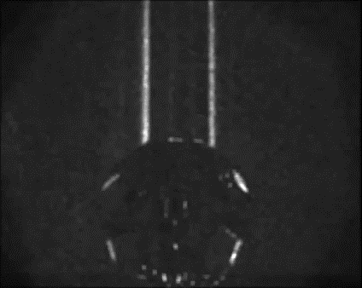
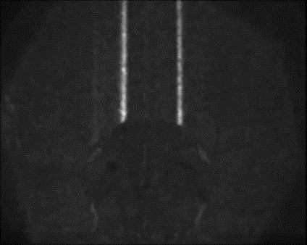
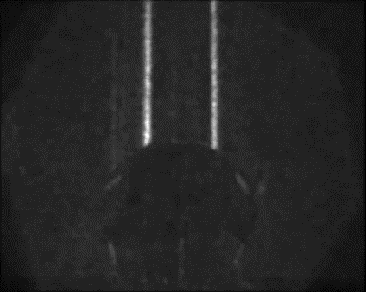




transient images v/s orientation
$$↔$$
$$ℱ$$
$$↔$$
$$ℱ$$
source
probing
source
probing
$$↔$$
$$ℱ$$
$$↔$$
$$ℱ$$
source
probing
source
probing
Notes:
Using this modified system, we can capture spatially-probed transient sequences, for example using probing patterns that filter different light transport effects in the scene.

Slide 54
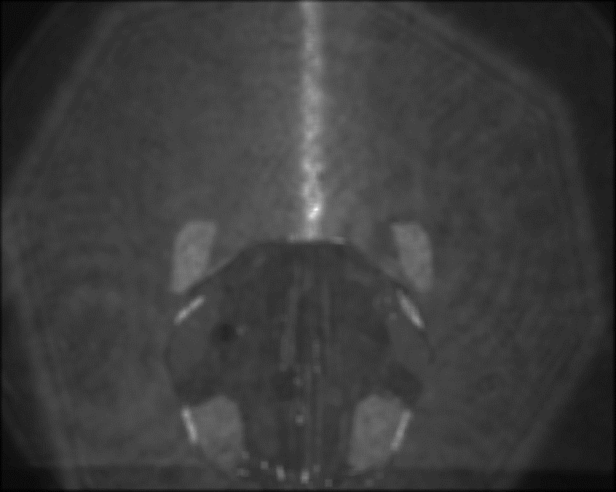


path orientations
(a)
(b)
(c)
(d)
$$↔$$
$$ℱ$$
$$↔$$
$$ℱ$$
source
probing
source
probing
Notes:
To see this better, let us freeze on one frame of the transient sequence. As we change the probing patterns, only those light paths aligning with the pattern light up in the frame.

Slide 55
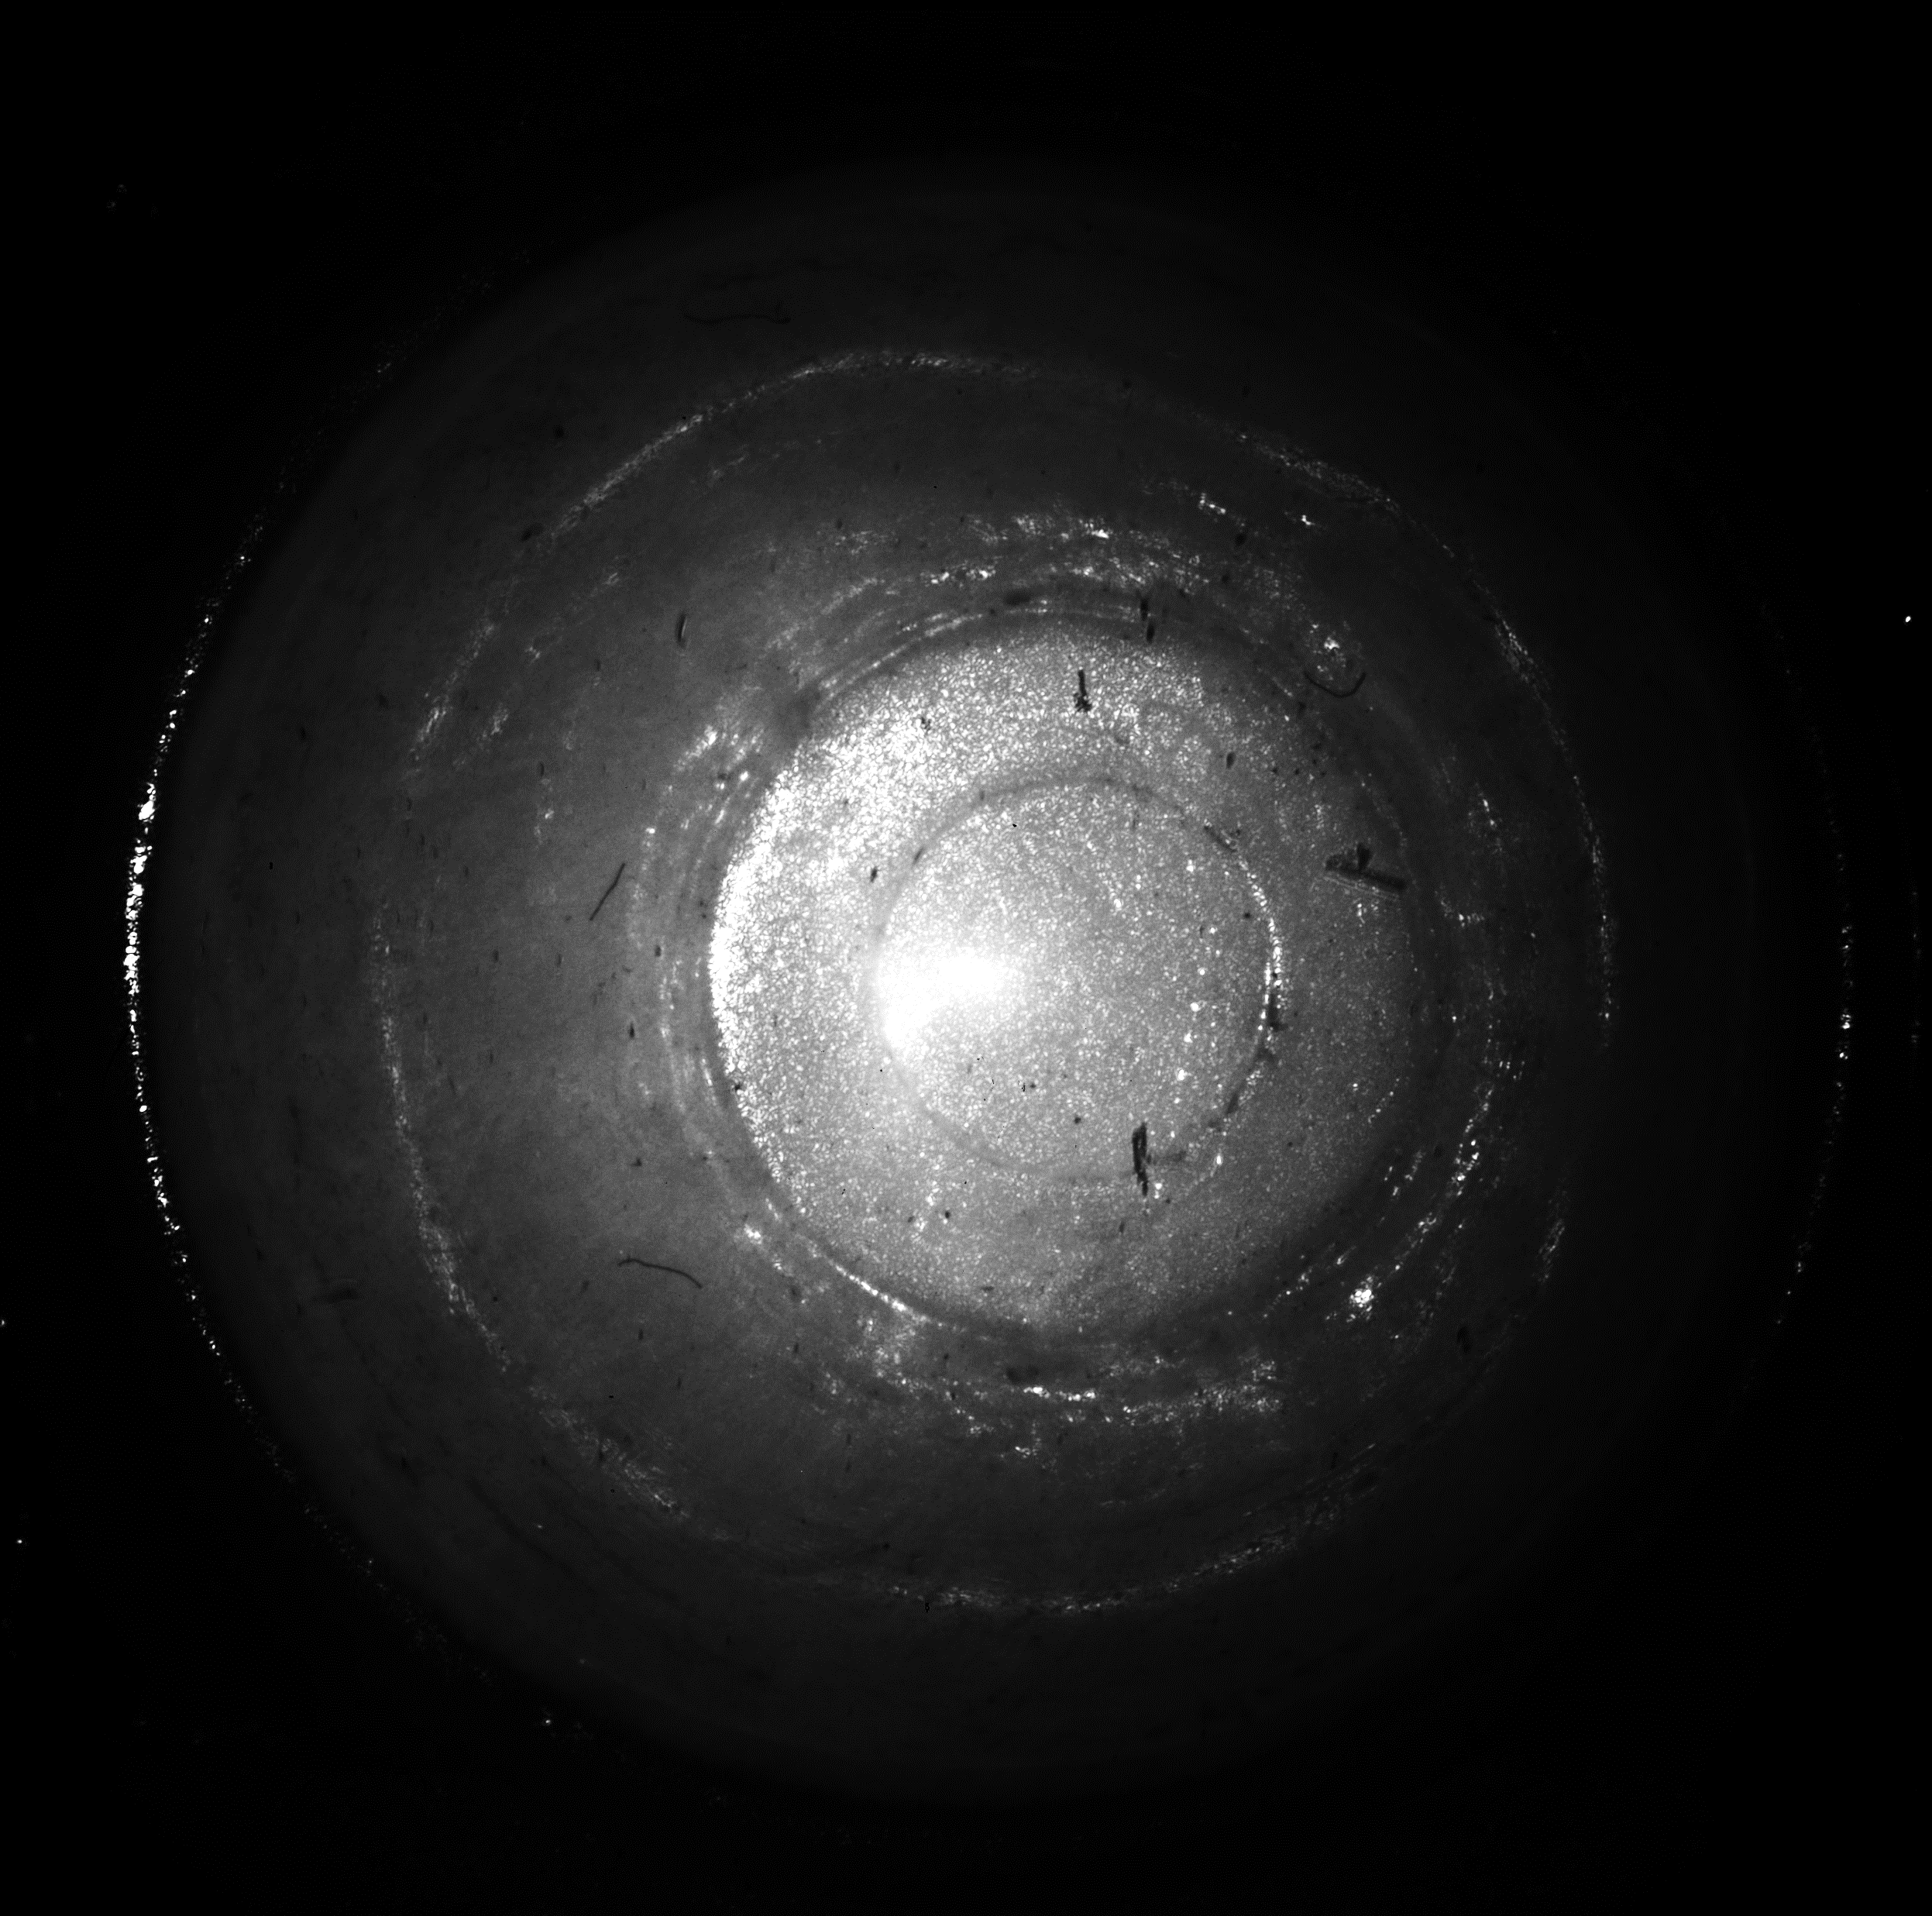
retroreflective paths
Notes:
Here is another example using the cup scene we showed earlier.
[C] We can use transient imaging to isolate the retroreflective specular paths into one frame, forming a ring of light inside the cup.

Slide 56
retroreflective paths
$$↔$$
$$ℱ$$
source
probing
Notes:
In the cup scene, we can use transient imaging
[C] to isolate a ring of retroreflective paths. Different points on this ring represent light traveling in different directions: for example,
[C] the points at the top and bottom show light traveling vertically,
[C] By changing our probing pattern, we can keep light traveling at any orientation we want, corresponding to the rotating caustic.

Slide 57

retroreflective paths
$$↔$$
$$ℱ$$
$$↔$$
$$ℱ$$
source
probing
source
probing
Notes:
In the cup scene, we can use transient imaging
[C] to isolate a ring of retroreflective paths. Different points on this ring represent light traveling in different directions: for example,
[C] the points at the top and bottom show light traveling vertically,
[C] By changing our probing pattern, we can keep light traveling at any orientation we want, corresponding to the rotating caustic.

Slide 58
PROBING COHERENT TRANSMISSION
Notes:
Finally, I want to briefly show you some results on probing coherent transmission.

Slide 59
Light transport probing
 |  |  | $$I_{c,s}$$
 |  |  | $$α_{c,s}$$
1
1
1
1
1
1
1
1
$$=$$
○
interference
image
light transport matrix
probing matrix
adding
up
Notes:
Till now, we were working on image intensities, which can be described using the light transport framework for incoherent light propagation.

Slide 60


Coherent transmission probing
 |  |  | $$T_{c,s}$$
 |  |  | $$c_{c,s}$$
1
1
1
1
1
1
1
1
$$=$$
○
interference
wave
coherent transmission matrix
mutual intensity matrix
adding
up
Notes:
As we discuss in our paper, our system can be used to directly probe and measure complex waves, instead of incoherent intensities.
In this case, the light transport matrix is replaced by the coherent transmission matrix. And the probing matrix is replaced by the mutual intensity matrix. All quantities are complex phasors, rather than real-valued intensities.

Slide 61
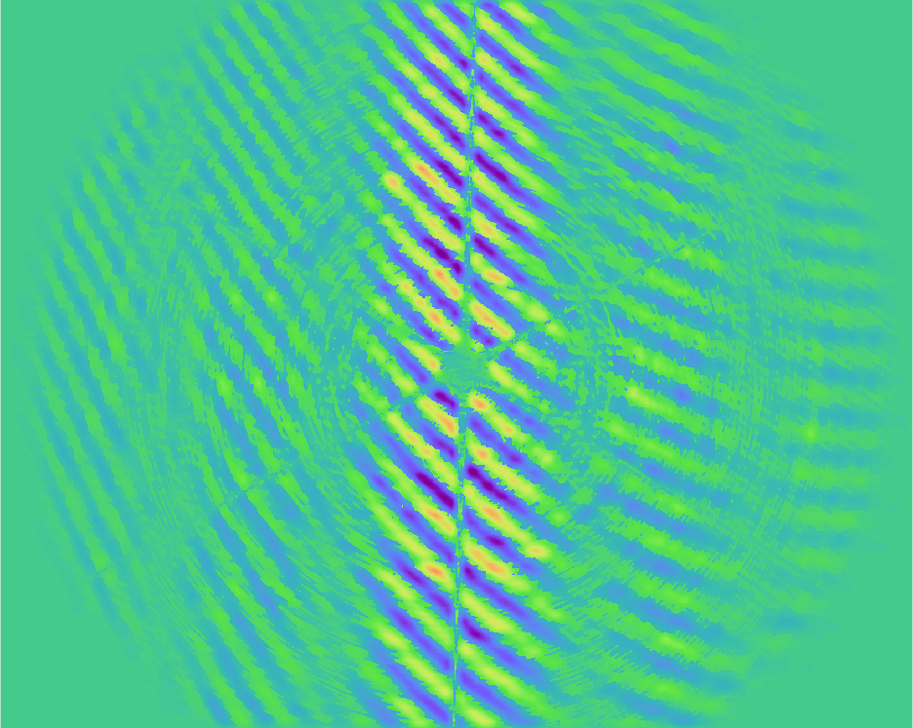
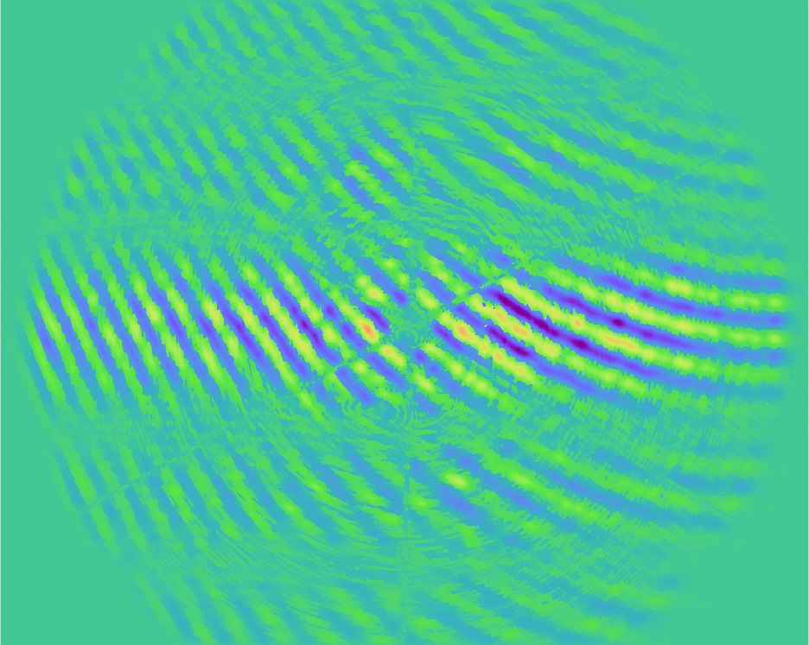
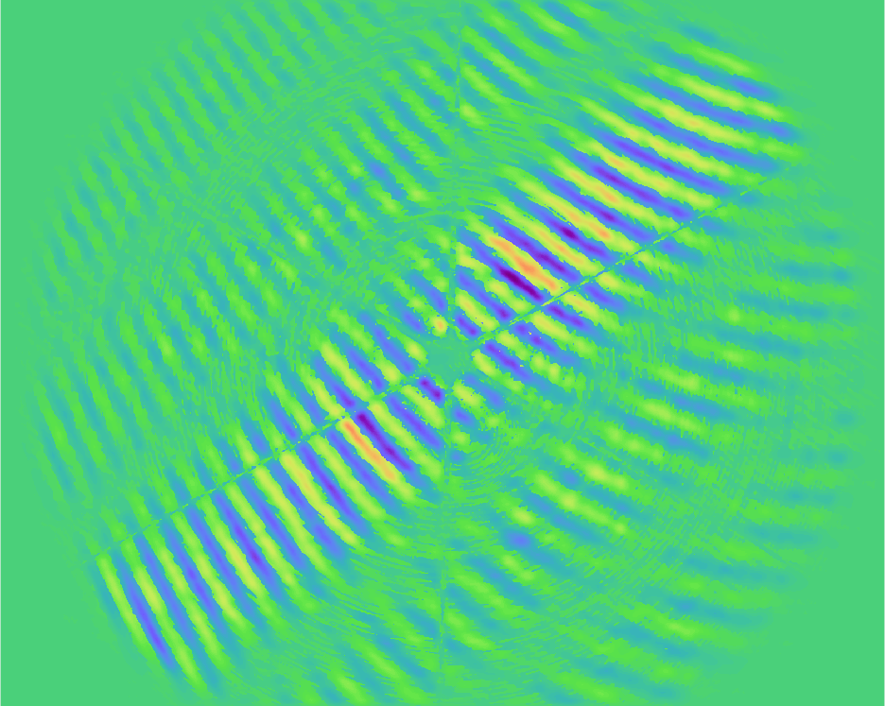



Mutual intensity visualization
sources
mirror
$$↕ℱ$$
$$↕ℱ$$
$$↕ℱ$$
mirror
mutual intensity patterns
Notes:
As a simple example, we use a scene consisting of a retroreflector, which is two mirrors placed at right angles.
This scene has the property that its complex interference is exactly equal to the mutual intensity generator. We can therefore use it to visualize the Fourier transform of the source’s amplitude profile:
[C] for instance, a horizontal source creates a vertical sinc pattern,
[C] a vertical source creates a horizontal pattern,
[C] and an angled pattern creates a pattern rotated by 90 degrees.

Slide 62


Mutual intensity visualization
sources
mirror
$$↕ℱ$$
$$↕ℱ$$
mirror
-
+
-
mutual intensity patterns
Notes:
Similarly, a Gaussian source produces a Gaussian pattern.
[C] Working in the coherent domain allows us to do probing with negative values. For example, on the right we show how to create a pattern that is shaped like a Laplacian function, where the main lobe is positive, and the side lobes are negative.

Slide 63






Summary
or, light transport probing,
1
1
1
1
1
1
1
1
camera
filtering
light
paths,
$$°$$
is done with
interferometry
$$I_{c,s}$$
$$α_{c,s}$$
 | 1 |  |  | 0 |  |  | 1
 | 0 |  |  | 1 |  |  | 0
 | 1 |  |  | 0 |  |  | 1
$$W(x)$$
with
mutual intensity
$$ℱ$$
$$A(θ)$$
selecting the right source
Notes:
To summarize:
[C] Motivated by microscopic imaging applications,
[C] we introduced a technique for light transport probing.
[C] Our technique is interferometric,
[C] And uses sources with programmable mutual intensity properties.
[C] We discussed how to implement these in an optical setup,
[C] And showed several results captured with a physical prototype.

Slide 64




Thanks for your attention!
code and data here:
many thanks to our sponsors:
https://tinyurl.com/CoherentProbing
https://seebelowtheskin.org
Notes:
Thanks for listening! Please make sure to visit our website for our code and data, as well as for more information on the see below the skin project.

