Slide 1
A Theory of Fermat Paths for Non-Line-of-Sight Shape Reconstruction
Shumian Xin, Sotiris Nousias, Kiriakos N. Kutulakos, Aswin C. Sankaranarayanan, Srinivasa G. Narasimhan, and Ioannis Gkioulekas
http://imaging.cs.cmu.edu/fermat_paths
Notes:
Hello everyone. I am going to show you a bunch of shape reconstructions of various objects, including a concave glossy bowl, a purely specular sphere, and so on.

Slide 2
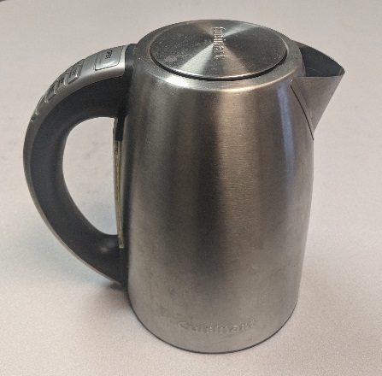
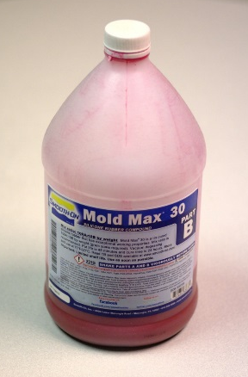
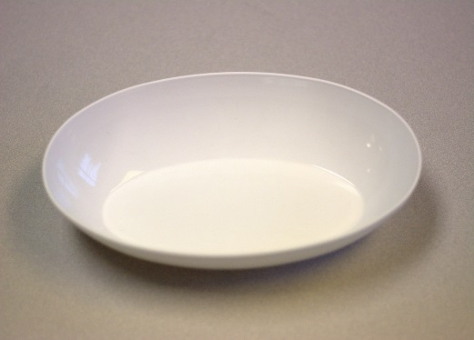
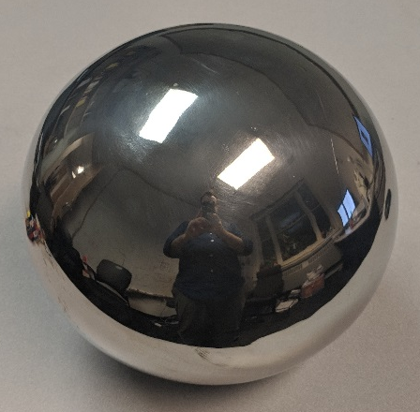
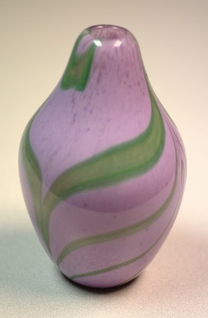
http://imaging.cs.cmu.edu/fermat_paths

Slide 3
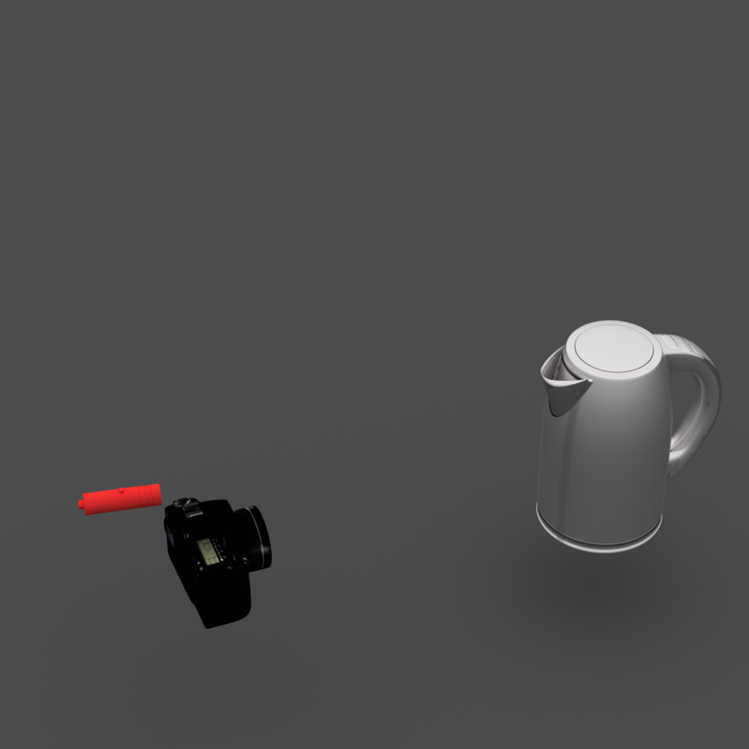
Line-of-Sight (LOS) Imaging
stereo
photometric stereo
structured light
laser ranging
LOS object
source & sensor
http://imaging.cs.cmu.edu/fermat_paths
Notes:
If I asked you how you would reconstruct these objects, you might answer that you will have a camera, and maybe a light source, face the object, and then use techniques such as structured light, and photometric stereo.

Slide 4
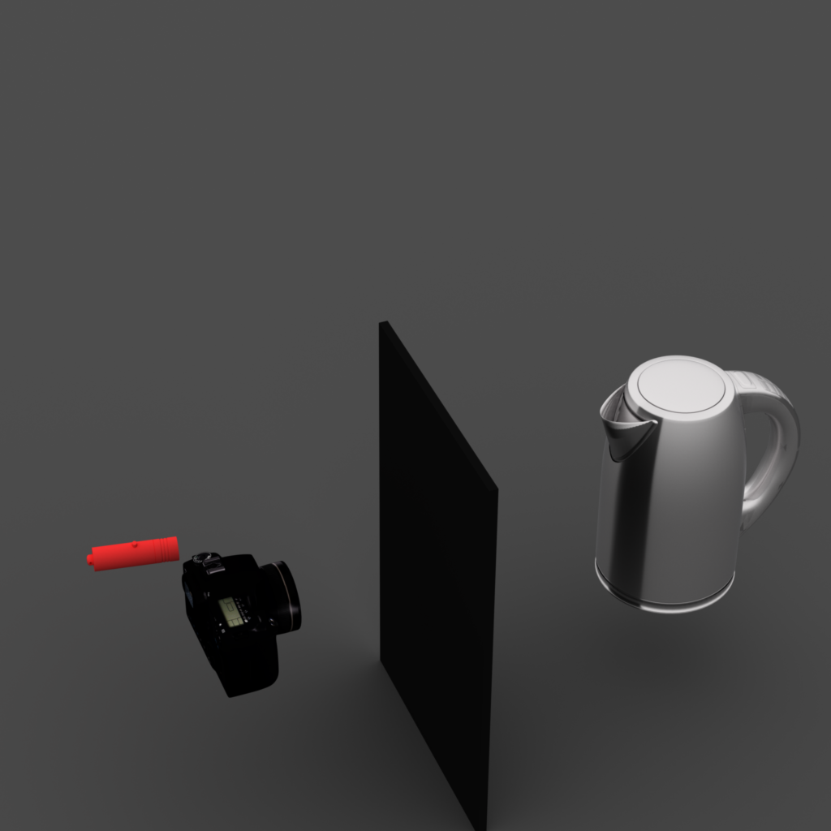
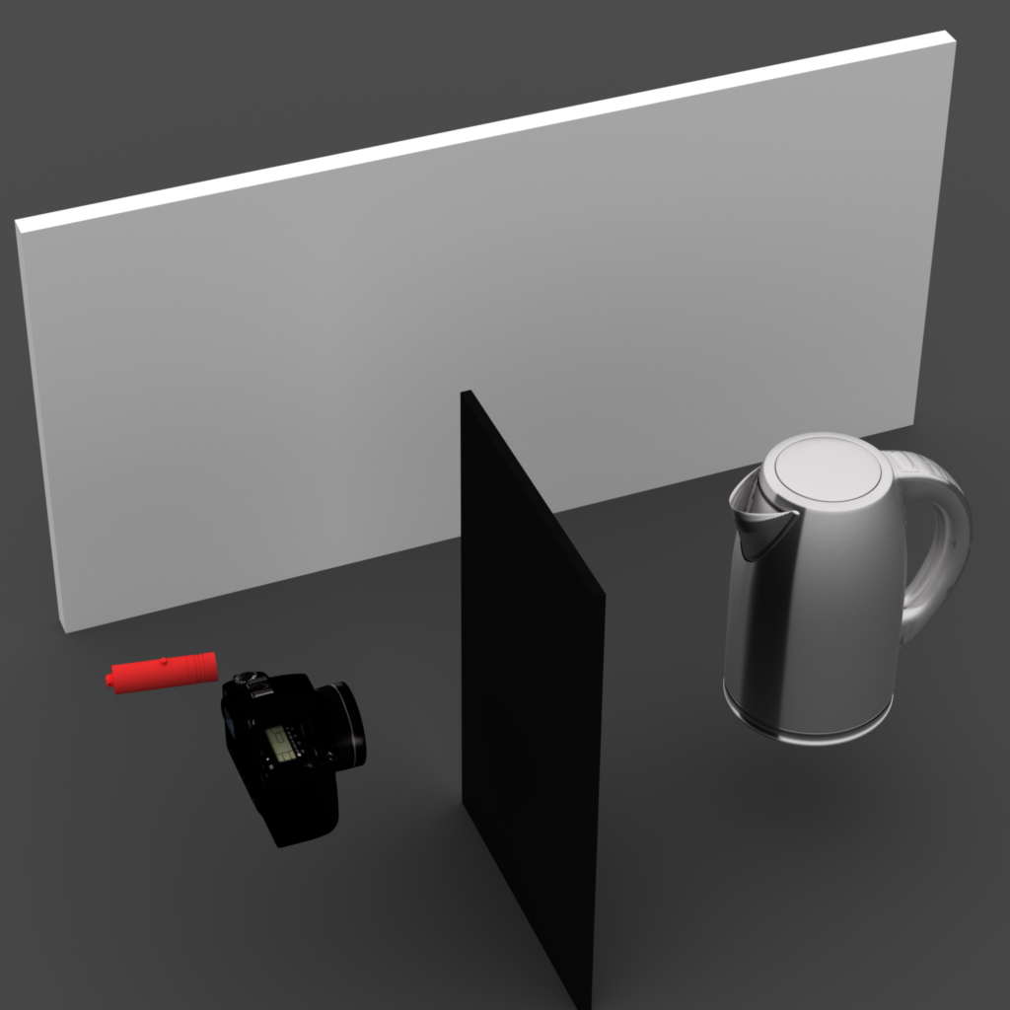
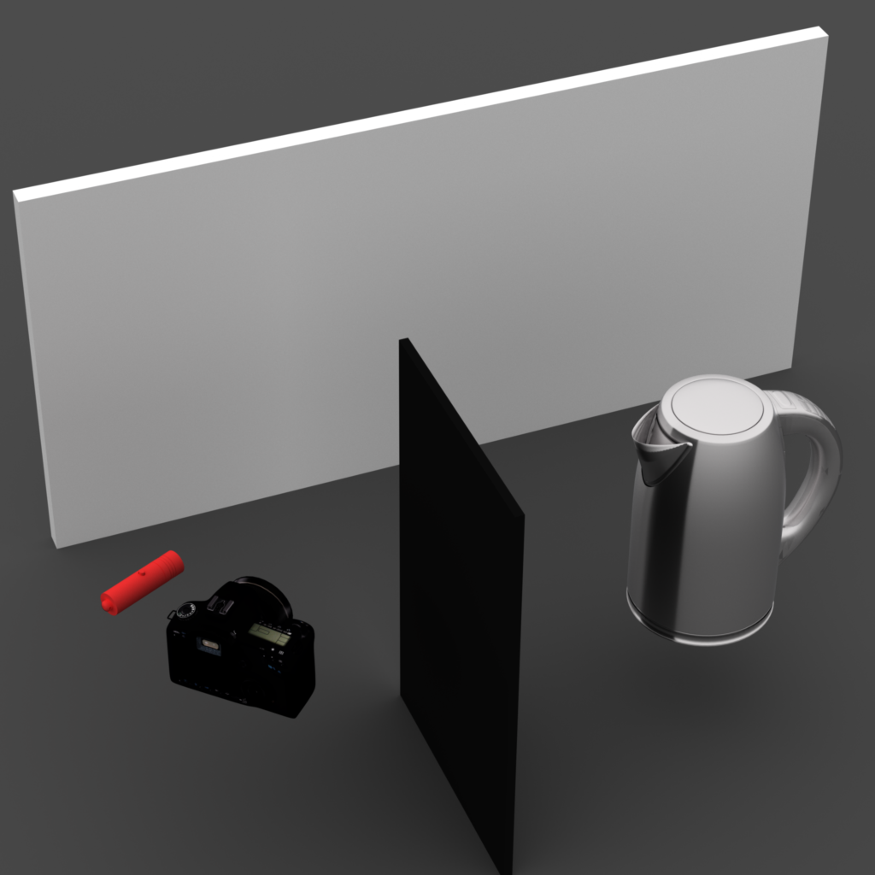
Non-Line-of-Sight (NLOS) Imaging
relay wall
$$y$$
intensity (# photons)
scan point
$$τ$$
time
$$τ$$
$$x$$
transient measurements
new theory & algorithm: Fermat paths
NLOS object
source & sensor
occluder
http://imaging.cs.cmu.edu/fermat_paths
Notes:
What if I tell you that the object is not even visible to the camera, (click) and the camera only observes it indirectly through reflections on a diffuse wall. As in previous talks, this setting is called non-line-of-sight imaging.
But unlike the previous work, because we want to do high-resolution 3D shape reconstruction, (click) we need to use a time-of-flight sensor, like a lidar. At each point on this wall, it records a histogram of photons binned by their time-of-flight. We call this histogram a transient measurement.
I will show you how to use these transient measurements to do 3D shape reconstruction based on a theory that we call the Fermat paths.

Slide 5
Scanning Procedure
LOS Reconstruction
$$τ_{LOS}$$
$$=$$
intensity (# photons)
$$x$$
$$y$$
$$x$$
$$y$$
$$τ_{LOS}$$
$$τ$$
NLOS Reconstruction
$$τ_{NLOS}$$
$$ℱ$$
$$x$$
$$y$$
$$τ_{NLOS}$$
http://imaging.cs.cmu.edu/fermat_paths
Notes:
Just like a lidar, we scan the wall point by point. In each transient measurement, there is a sharp rise at the beginning. This is a discontinuity in time.
The timestamp of this discontinuity is proportional to depth. We use these timestamps to reconstruct the planar wall as shown on the right.
The lidar only keeps the first discontinuity, and throws away the rest of the transient measurements. But, notice that, there is an additional tiny signal (click), due to the indirect photons from NLOS object.
These indirect transients also have discontinuities, and we can again record their timestamps during scanning. Different from the LOS case, we can then recover the NLOS shape using a nonlinear transformation of the recorded timestamps.

Slide 6
roughly specular
translucent
glossy
Advantages:
high resolution
BRDF invariance
convex & concave shapes
specular
dichromatic
http://imaging.cs.cmu.edu/fermat_paths
Notes:
Because our method is purely geometric, (pause) it has a few advantages.
We get high resolution, comparable to LOS.
We can handle arbitrary shapes.
And we can deal with materials including purely specular, which are traditionally considered difficult.

Slide 7
What are Fermat paths?
Fermat pathlengths = discontinuities
Fermat paths =
specular or boundary
relay wall
scan point
scan point
relay wall
$$l_{ℱ}=\frac{τ_{NLOS}∙c}{2}$$
specular:
ray parallel to surface normal
intensity (# photons)
NLOS object
source & sensor
$$τ_{NLOS}$$
$$τ$$
occluder
NLOS surface
time
http://imaging.cs.cmu.edu/fermat_paths
Notes:
Now let’s take a look at the theory behind this. For simplicity, I will explain in 2D. (click)
As I mentioned before, the indirect transients will always have discontinuities. (click)
We can prove that their timestamps, up to the speed of light, correspond to lengths of a special set of photon paths called Fermat paths.
(click) These paths are either specular or at the object boundary. They are called Fermat after Fermat’s principle, meaning that they have locally stationary pathlengths.

Slide 8
Fermat Flow: Point and Normal Reconstruction
Fermat pathlengths = discontinuities
Fermat paths =
specular or boundary
scan point
$$v+dv$$
$$v$$
relay wall
$$θ$$
$$\cos{θ}=\frac{dτ}{dv}$$
$$n_{NLOS}$$
$$x_{NLOS}$$
intensity (# photons)
sphere-ray
intersection
$$τ_{NLOS}+dτ$$
$$τ_{NLOS}$$
$$τ$$
NLOS surface
time
http://imaging.cs.cmu.edu/fermat_paths
Notes:
From the discontinuity timestamp, we know the length of the Fermat path but not the path itself. From this, we know that there is a NLOS point on a sphere of radius half the Fermat pathlength around the scan point.
To find the point exactly, we derive an additional geometric constraint that we call the Fermat flow constraint: (click)
It says if we slightly perturb the scan point, the corresponding transient and its discontinuity timestamp will also change by a small amount. (click)
We can prove that, the rate of this timestamp change defines a ray that is parallel to the Fermat path. (click)
Then, we can get the NLOS point, and also its normal, simply through a sphere-ray intersection. This theory is closely related to the signed-distance function and its gradient.
I will show you some additional results to demonstrate the accuracy of our method.

Slide 9
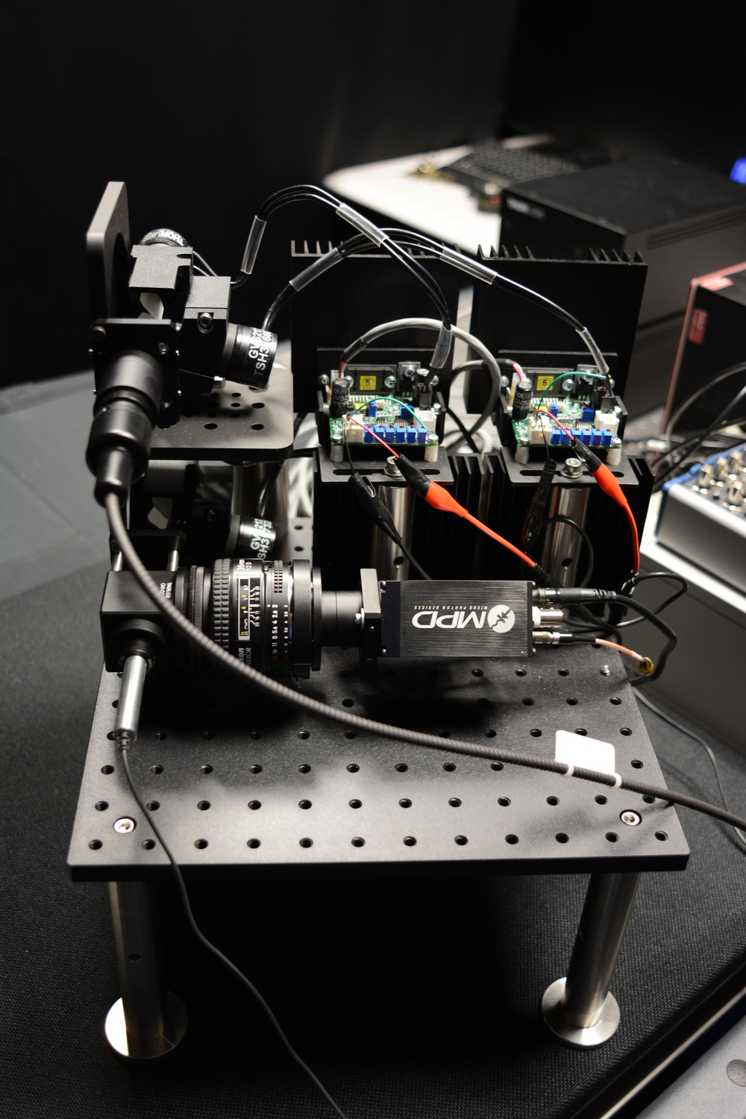
Picosecond-scale Setup
galvo
laser
SPAD
galvo
transient imaging using SPAD (single-photon avalanche diode)
http://imaging.cs.cmu.edu/fermat_paths
Notes:
Both these and the earlier results were captured with a picosecond-resolution imaging setup, consisting of: a single-photon sensor, a pulsed laser, and scanning optics.
Using our very low-power laser, each scan takes about an hour. With other higher-power lasers, this can be reduced to a few minutes.

Slide 10
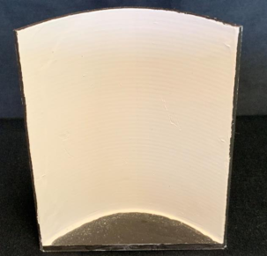
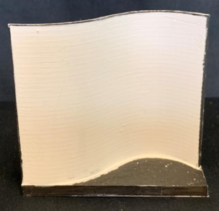
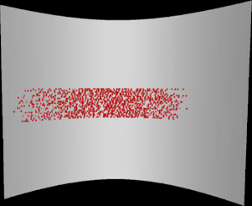
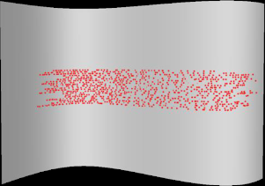
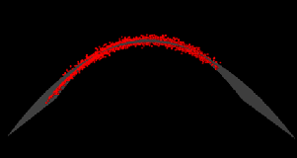
Picosecond-scale Reconstructions
SPAD-based setup
resolution: 1.2mm (4ps)
objects 10 x 10 cm
average error 2mm
NLOS reconstructions
http://imaging.cs.cmu.edu/fermat_paths
Notes:
This system has a resolution of 4ps or 1.2mm.
We scanned small 3D printed objects for which we have groundtruth shapes.
Our reconstructions match the groundtruth at an average error of 2mm, which is very close to the sensing resolution limit of the system.

Slide 11
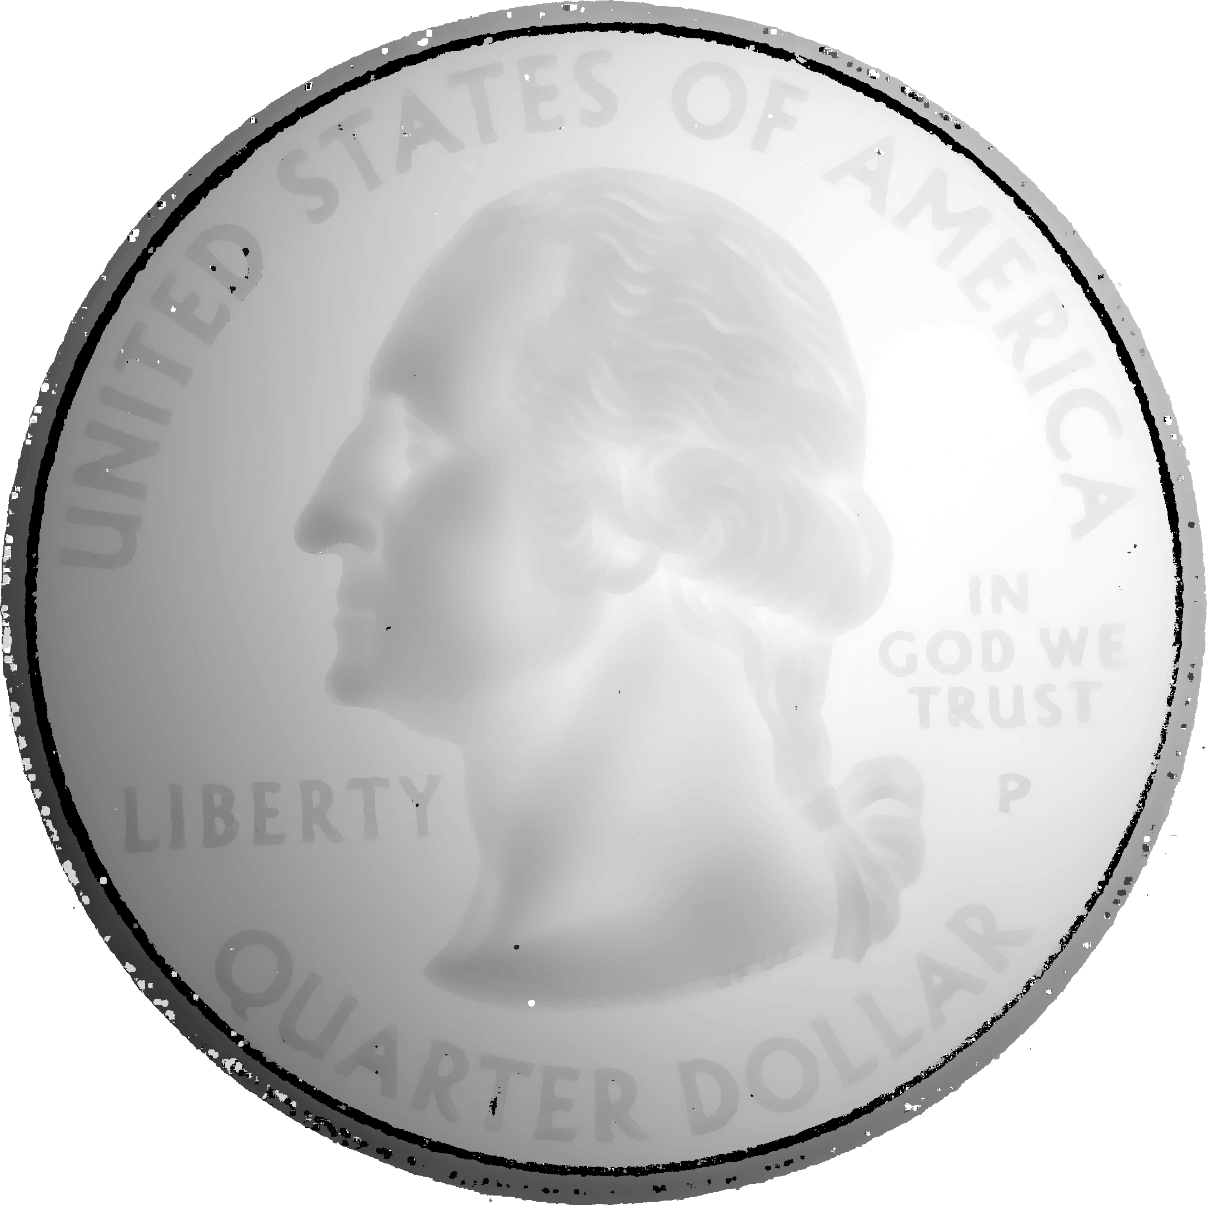
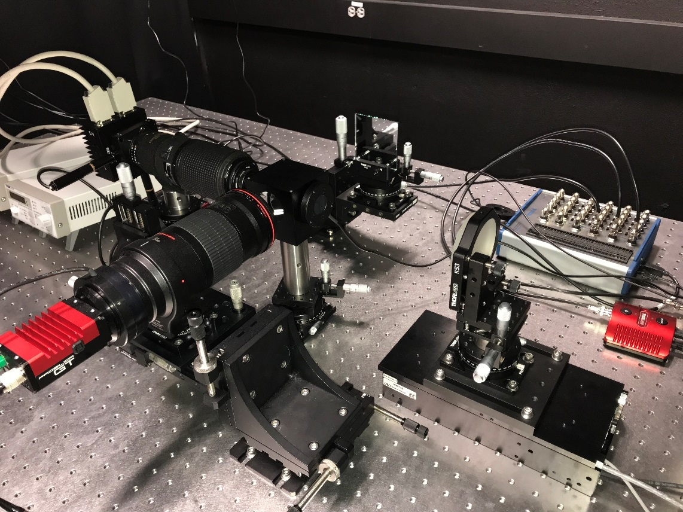
Femtosecond-scale Reconstructions
500 μm
NLOS
LOS
depth
optical coherence tomography (OCT)
resolution: 10 μm (33 fs)
horizontal location
ground truth (LOS scan)
NLOS reconstruction
http://imaging.cs.cmu.edu/fermat_paths
Notes:
What if we want to increase the resolution by a thousand time, to micron-scales. For this, we need femtosecond-scale transient measurements, which we can obtain using OCT systems.
We scanned a US quarter in both LOS and NLOS settings, as shown here. (click) If we look at a cross-section of the reconstructions, (click) we see that our algorithm can accurately reproduce micron-scale details of the coin, even when it is fully occluded.

Slide 12
Thank you!
Poster #134
http://imaging.cs.cmu.edu/fermat_paths
Notes:
In summary, it’s exciting to see that these reconstructions are starting to look like LOS reconstructions. Thank you!

